Slide 1
2017 Joist
Moderator: Marvin Freeman
Presenter: Ryan Vanek

Slide 2
Joist
BIM and System joists have been merged, taking the benefits of both
System
Node matching
Framing situation
Connection Design
BIM
3D Solids
Joist shapes

Slide 3
Joist
Jobs with joist, converted from 2016, will change the joist to the new style.
Added at bearing elevation.
New locate modifier to add at top of joist elevation.
Display feedback to show elevation at top chord and bearing.
Shapes
Parallel
Single Pitch
Double Pitch
Arched Chord
Bowstring
Scissor
Triple Pitch
BIMCustom

Slide 4
Joist
Panel display method
Automatic
Reserved
Mfg pre-config.
User pre-config.
Joist Manufacturer Manager
Found in Utility Functions
Canam
Vulcraft

Slide 5
Joist
Job Options – Joist Manufacture Setup
Joist manufacturer
Reads from Joist Manufacturer Manager
Panel display method
When joist manufacturer is change it will update all joist in the model that are not model complete.

Slide 6
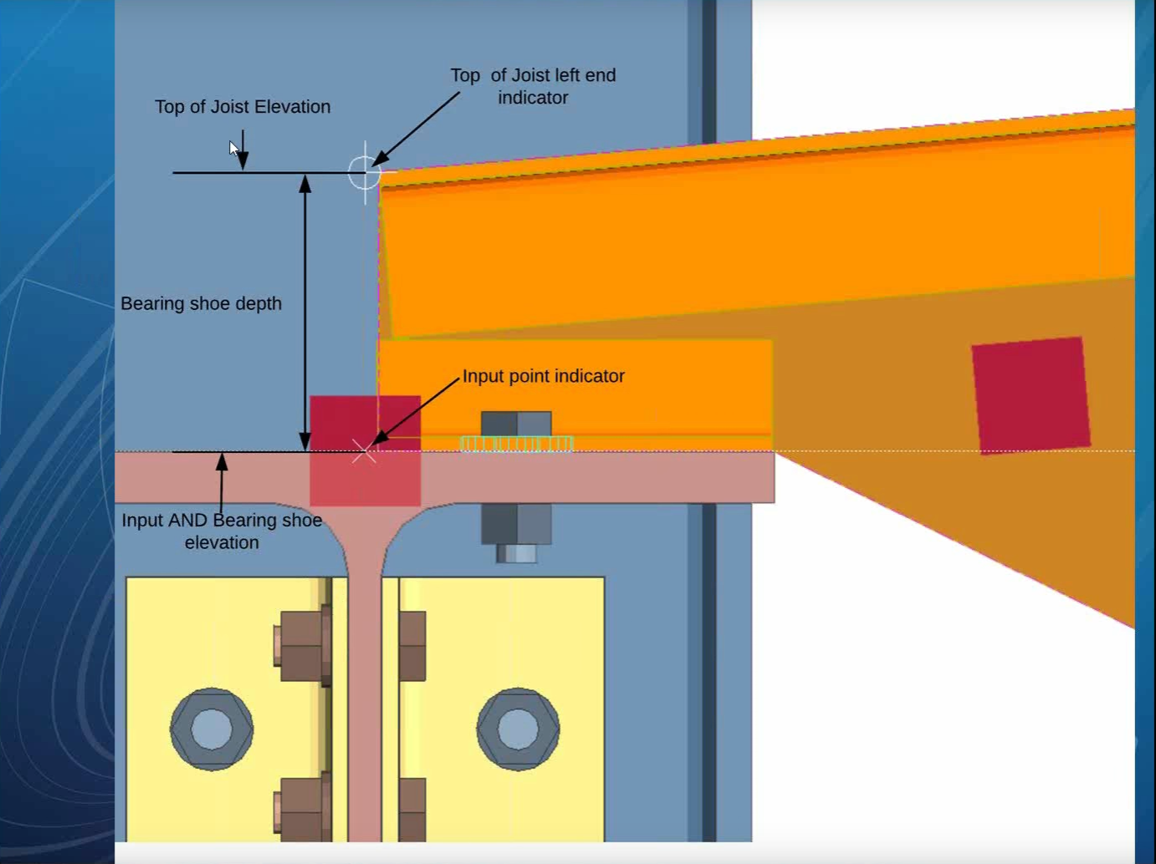
Joist

Slide 7
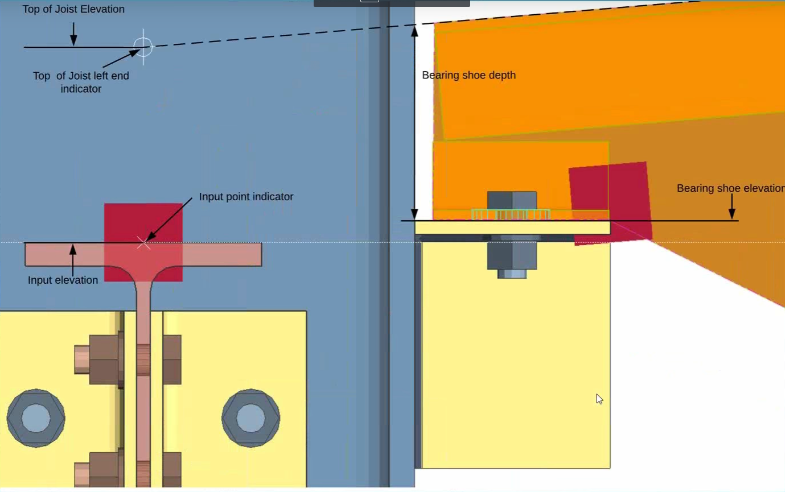
Joist

Slide 8
Joist
Auto standard connections
User Interface changed
Joists added to beam and column
Auto cap plate when joist is added to top of column.
Bolt Design Criteria
Setup for all joist types

Slide 9
Joist
Setbacks and Extensions
Chord only(S type) extension
Applies to top chord only
Full(R type) extension
Applies to top chord and shoe
Bearing shoe slots
Slot diameter
Slot length
Slot edge distance NS and FS
Bolts
Bolt diameter
Distance to holes
Gage

Slide 10
Joist
Joist Setup found in Standard Fabricator Connections
Bearing connections
OSHA span for bolted connections
Will change to bolted connection if over the value set here.
Joist type specific setting
Minimum shoe length
Shoe slot diameter
Stabilizer angle
Stabilizer plate

Slide 11
Joist
Joist Reports
Bill of material for the joist
CB - Top chord bearing length
TCX – Chord extension and base length
Erection Views
Shows extensions
Section views in wire will show the joist material

