Slide 1
2017 Member Pins
Moderator: Brian Cobb
Presenter: Ryan Vanek

Slide 2
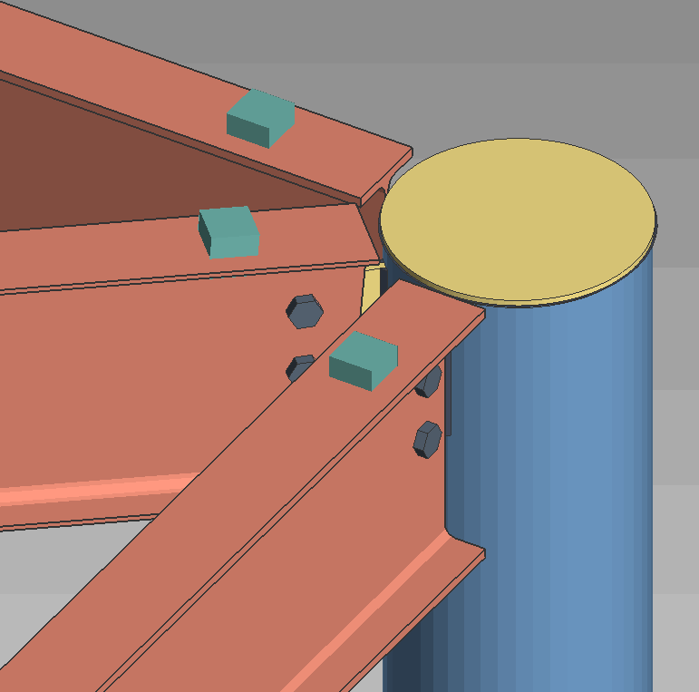
Member Pins
Pins will associate a members end with members or views in the Model
Added to the member end and can be edited.
Member ends can be pinned to:
View
Member end
Member line
Member plane
It’s own plane
Pins will adjust member ends when:
Members move
Members are changed(Section Size)
Member elevation changes
Grid Lines are moved

Slide 3
Member Pins
Auto pins that will be applied:
Beams
To views
To members
To its own plane
Columns
To views
Vertical Brace
To views
To members
Spliced Ends
Horizontal Brace
To views
To members
To other member plane
Joist
To views
To members
To its own plane
Stair and Handrail
To views
Misc.
To views
Truss
Even spaced members

Slide 4
Member Pins
Job Setup option: Default new members to disabled restraints
When unchecked pins will automatically get generated for most situations
When checked pins will not automatically get generated
Colors can be setup to represent the different types of pins
System
User
Disabled
Display Options: Member ends always displayed
Grid lines can now be moved

Slide 5
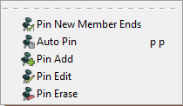
Member Pins
Pin New Member Ends
This will turn on the function if disable in setup
There is also a toolbar icon that will show if it is disable or enabled
Auto Pin
If pins were not generated automatically this function will apply pins to selected member ends
Pin Add
Manually adding pins to a member end
Pin Edit
Edit and manipulate auto or manual pins
Pin Erase
Deletes pins that have been applied to selected members

Slide 6
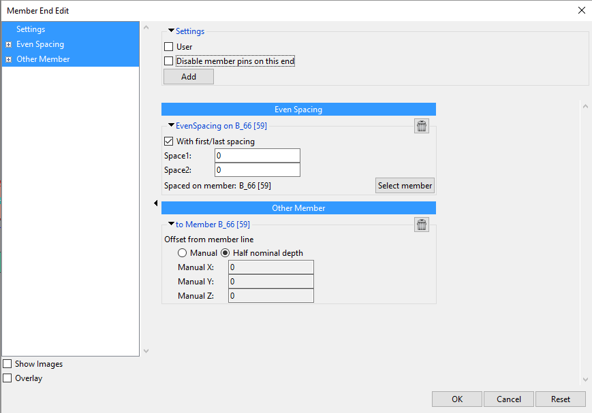
Member Pins
User pins
Pins will become user if they are modified or added manually
Disable member pins on this end
Pins that are disabled will be applied when the model is changed
Add
Pins can be added from the edit screen. This is the same functionality as adding the pins manually.

