Slide 1
SDS/2 2017 Modeling Enhancements
Presented By:
Tyler Dunkle

Slide 2
SDS/2 v2017 Modeling Enhancements
Display Options
Status display
Selection Filter by Status Display
Selection List
Status Select
Model Dimensions
Continued..

Slide 3
SDS/2 v2017 Modeling Enhancements
Dimension Clearance
Hide Selected/Unselected
Copy to Clipboard
Void space cylinder/layout
Extruded Profile Member
BentPL Member
Components
Connections

Slide 4
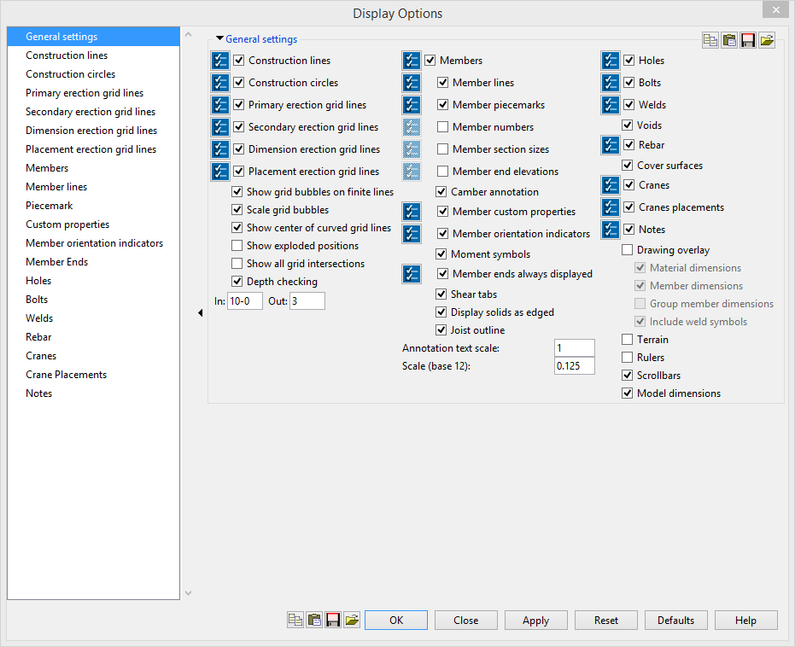
Display Options
Enhanced to give the user more options

Slide 5
Status Display
Transparency slide bar has been added to adjust the level of transparency.
Material type has been added.
Member setback options, load types, and many others added.
New conditions added
Group member status
Hole status
Weld status

Slide 6
Selection using Status Display
Selection Filter – By Status Display
Selection can be refined by properties found in Status Display
Items that can be selected:
Members
Connection Components
Member Ends
Holes
Bolts
Welds

Slide 7
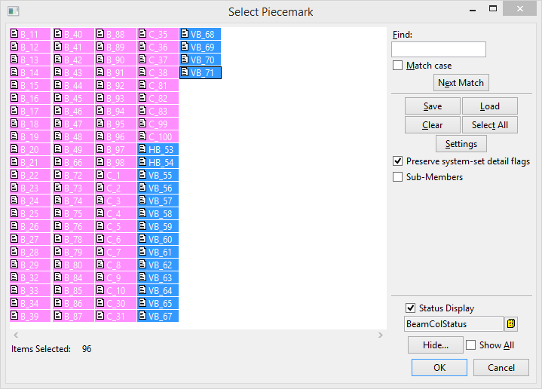
Selection Lists
You can now load a status display inside of a selection list.
You can mask, or change the colors of the piece marks.

Slide 8
Status Select
Status Display that will auto select in view by status.
Items that can be selected:
Members
Connection Components
Member Ends
Holes
Bolts
Welds

Slide 9
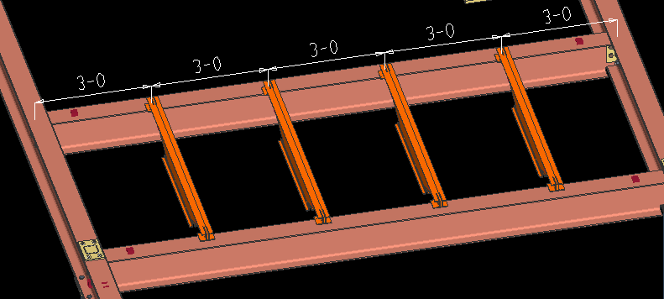
Model Dimensions
Add dimensions in the model regardless of the view you are in.
Dimensions will remain until you delete them, or erase all.
Dimensions Can be saved for a later time as well.

Slide 10
Dimension Clearance
Will find the dimension that is the closest between two materials selected

Slide 11
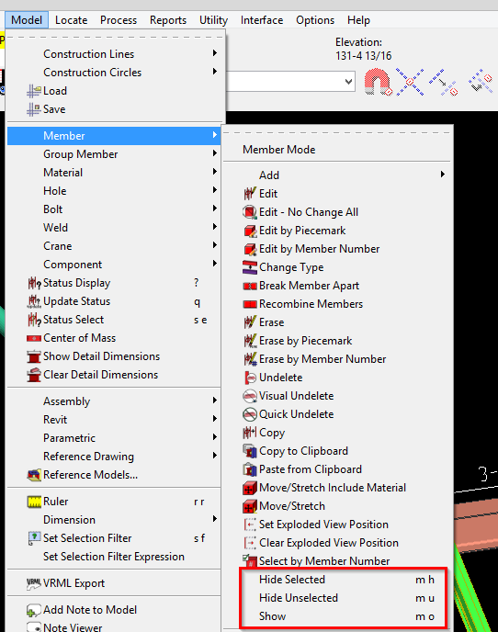
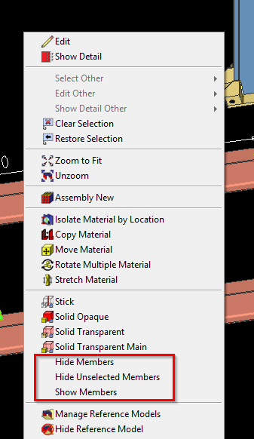
Hide Selected/Unselected
You can now hide specific members, hide the unselected members, and then show the members again in the model

Slide 12
Copy to Clipboard
You can now copy members between 2 jobs using the copy to clipboard command.
Copy to the clipboard will create a temp job behind the scenes where those members are being stored
Once you open the new job, you can “paste from clipboard”

Slide 13
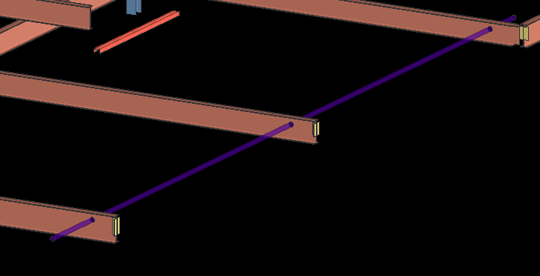
Void Space Cylinder/Layout
This is like cut layout but it will store your points and they are editable.
Voids can be moved, as material or member, and can be deleted.

Slide 14
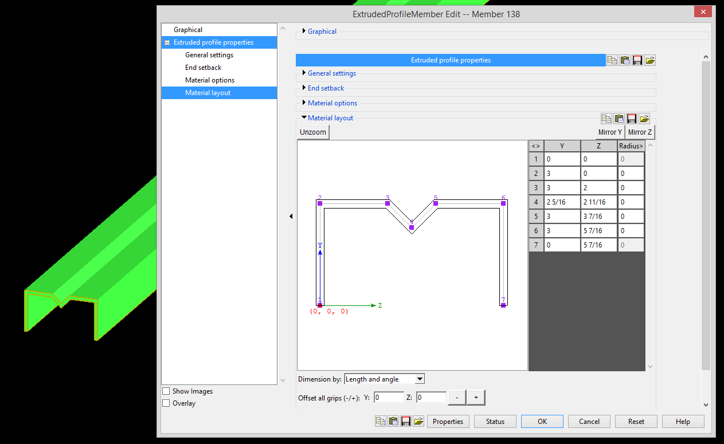
Extruded Profile Member
Allows a user to draw a profile/shape that they wish to extrude on the screen as a member or material

Slide 15
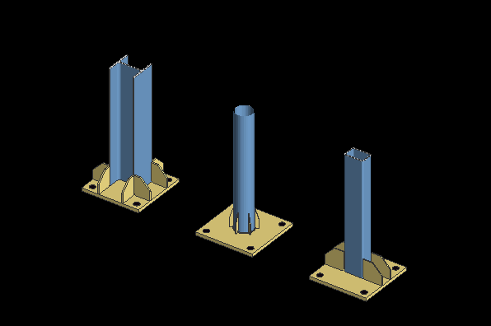
Components
Base/Cap Plate stiffeners
Works on wide flange, pipe, or tubes.

Slide 16
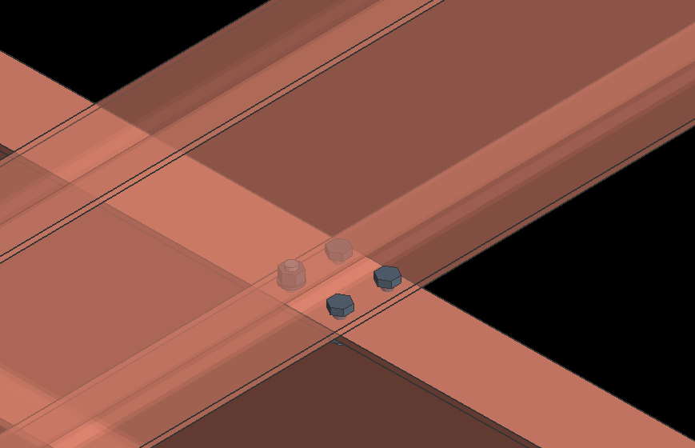
Components
Beam Flange to Flange Connection
Can now connect flange to flange by running a component.

Slide 17
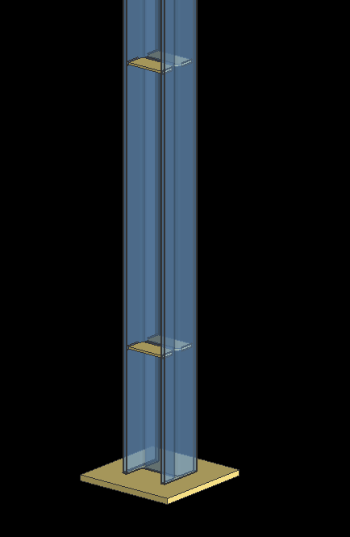
Components
Column Stiffener - Column
Can add stiffeners to columns by even spacing, picking points, or fixed spacing

Slide 18
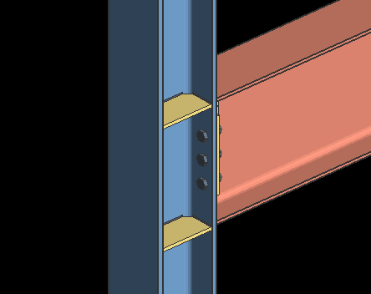
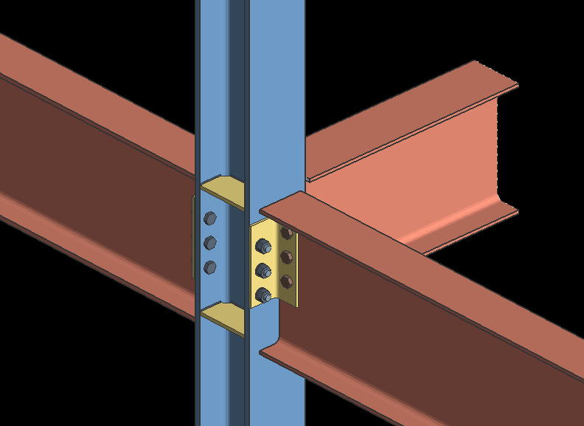
Components
Column Stiffener at Beam
Can add stiffeners to columns by selecting the beam framing into the column

Slide 19
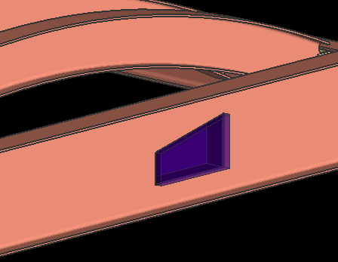
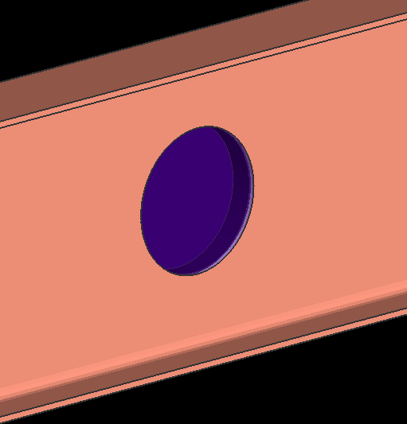
Components
Void space cylinder
Void space layout

Slide 20
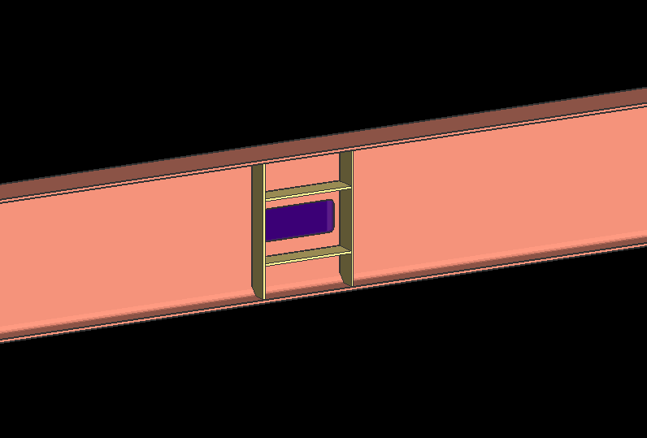
Components
Web Penetration with Stiffeners
Select the center of the opening on the x axis of the beam
Round or rectangular
Vertical and/or horizontal stiffeners

Slide 21
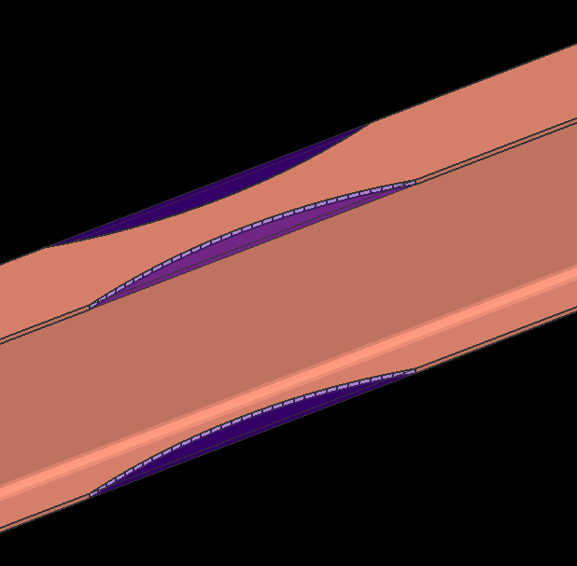
Components
Reduced Beam Section
Now uses void material for the cuts

Slide 22
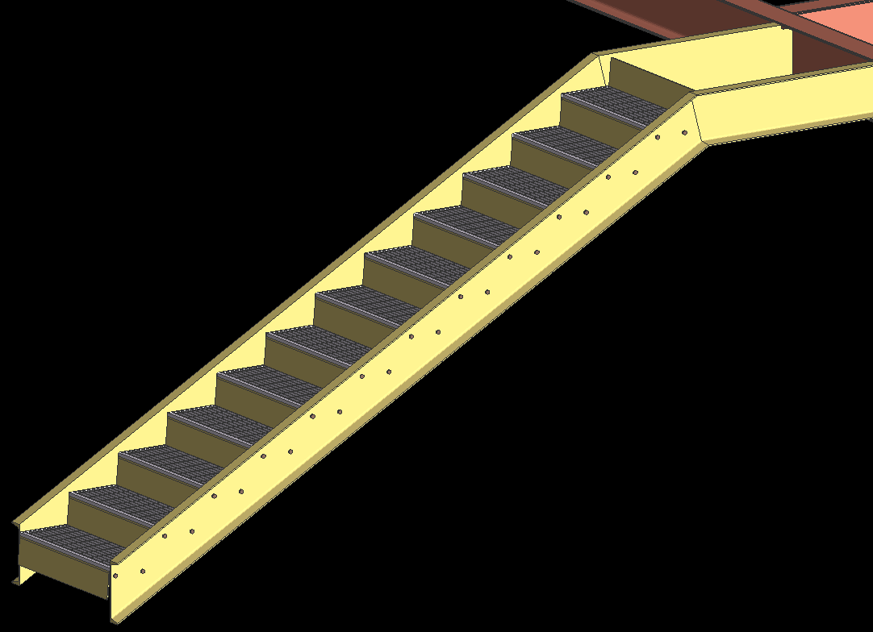
Components
Riser Closure Plate

Slide 23
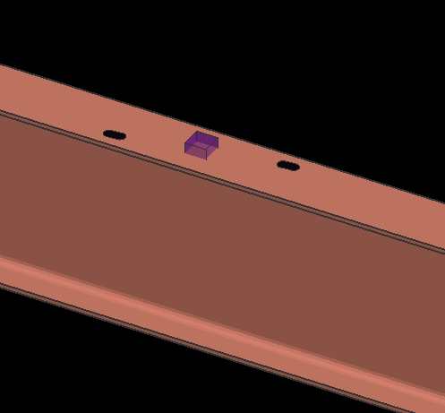
EZ Beam Release
Add holes for the E-Z Beam Release erection tool.

Slide 24
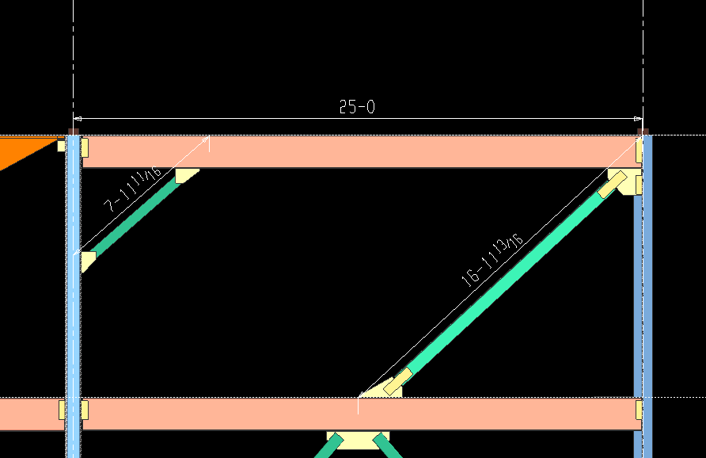
Dimension Members
For each selected member, it adds a dimension between its exact points.

Slide 25
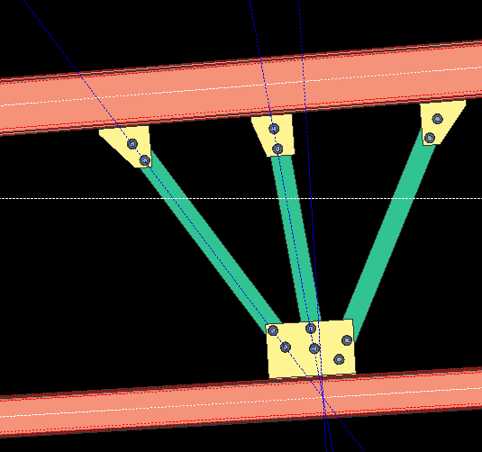
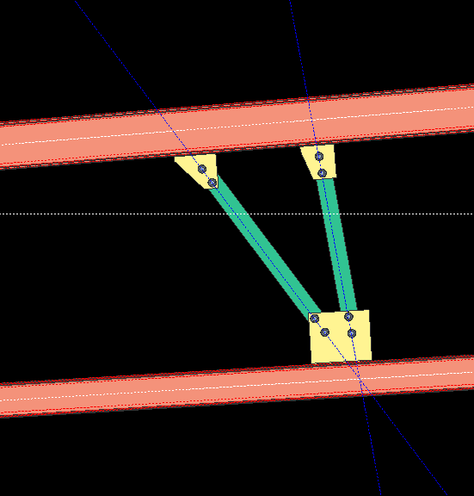
Connections
Improved 2 and 3 point brace geometry on vertical braces

Slide 26
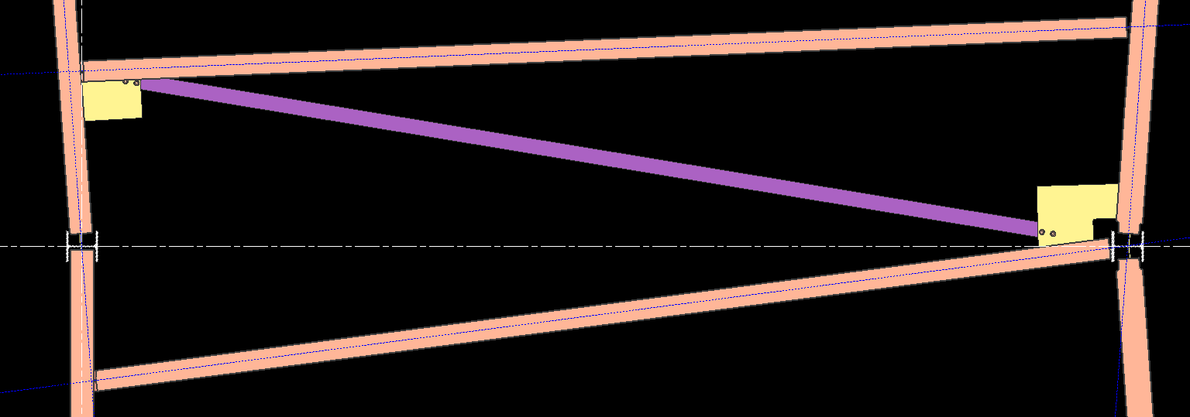
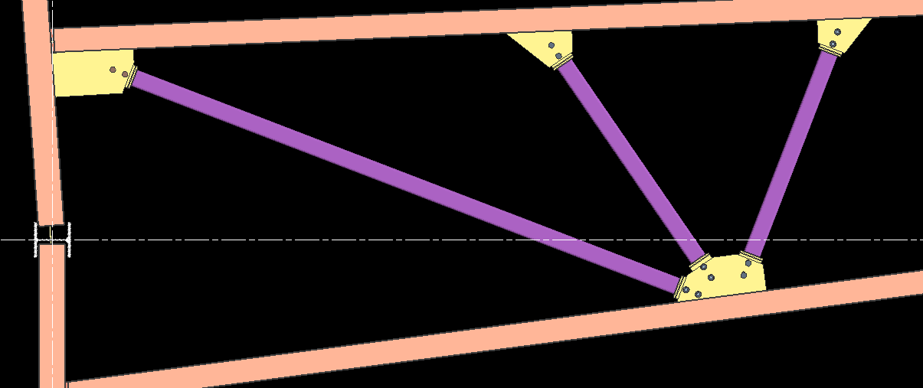
Connections
Improved brace geometry on horizontal bracing as well.

Slide 27
Connections
Seismic:
Removed the option to turn off horizontal and vertical brace gross capacity checks in Design Criteria
These options were left over from the AISC 1st edition of the Seismic Manual.
Options for SCBF or OCBF for vertical brace gusset design
Special Concentrically Braced Frame
Ordinary Concentrically Brace Frame

Slide 28
Connections
Now there is an option to only distribute a % of the UFM (uniform force method) vertical load from the beam to the gusset connection for vertical braces connecting to a beam/column interface

Slide 29
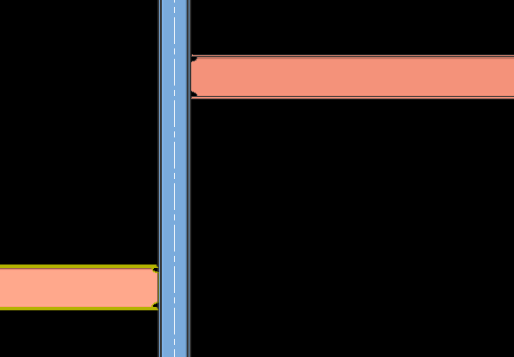
Connections
Fully Welded Moment
This will automatically set the moment to Welded
This will provide proper end preps and welds

Slide 30
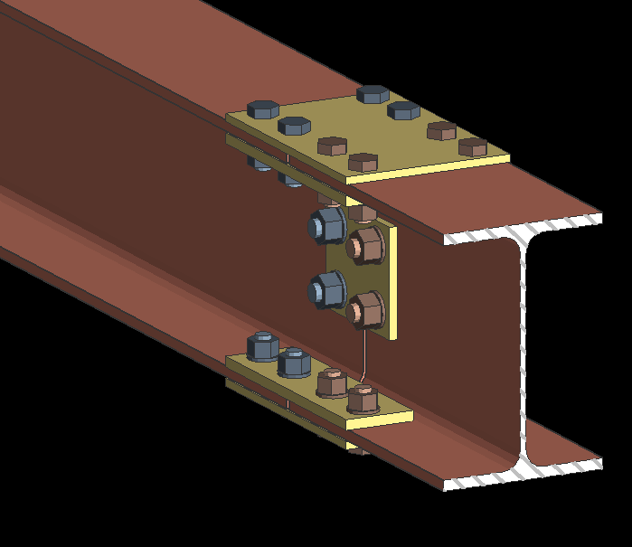
Connections
Inner Flange Plates
On a splice bolted moment connection you can now include inner flange plates.

Slide 31
Questions
Questions???

