Slide 1
Reference Models and Drawings
Track 1, Thursday, 9/28/17
2:20 – 3:40
Presented by Bruce Vaughan

Slide 2
Why Use Reference Models?
Place concrete, HVAC, plumbing, precast and other design elements in the SDS/2 detailing model.
Gets your model off to a quick start.
Helps to assure accuracy of the SDS/2 detailing model.

Slide 3
Use Reference Models Cautiously
Accuracy may not be assured or kept up to date, especially if the contract documents are drawings.
The reference model is only usable if it was input accurately.
Perform a QC check on the reference model before proceeding!

Slide 4
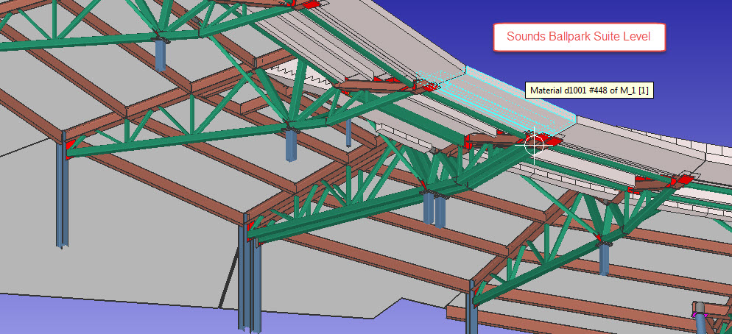
Reference Models in 7.3
In 7.3, Designlink was required to import IFC files into the model

Slide 5
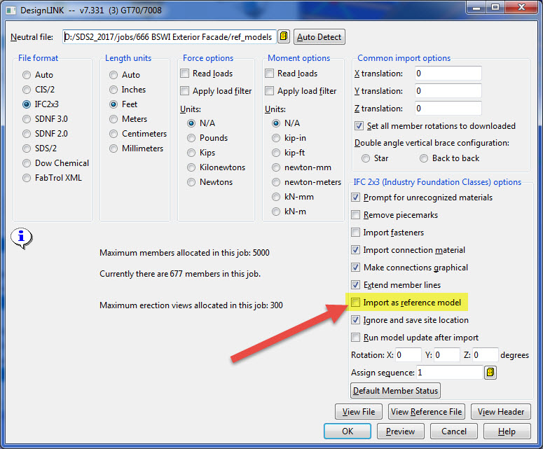
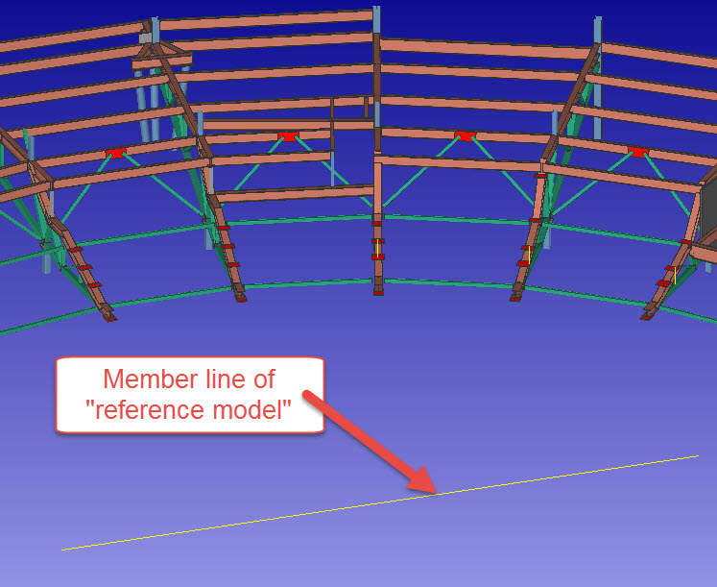
Reference Models in 7.3
Imported as reference model
Select option in Designlink window

Slide 6
Reference Models in 2015
In 2015 and higher, SDS/2 incorporated true reference models.
Designlink no longer required to import a reference model.
Use Designlink if you need individual members.

Slide 7
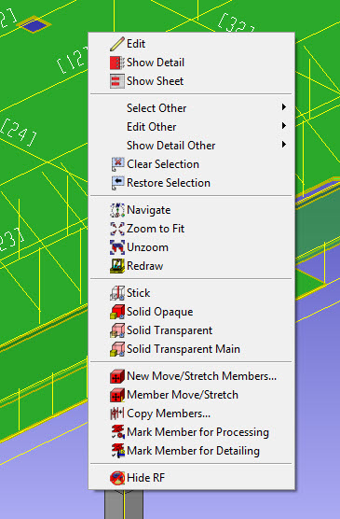
Context Menu
Modify the context (right-click) menu to be able to hide a reference model “on the fly”.

Slide 8
Reference Model Member Line
Reference models in 7.3 are miscellaneous members with a normal member line.
Reference models beginning in 2015 no longer have a member line the user can manipulate.
A reference model is either on or off.
Reference model “member lines” can be visualized in DE erection views.

Slide 9
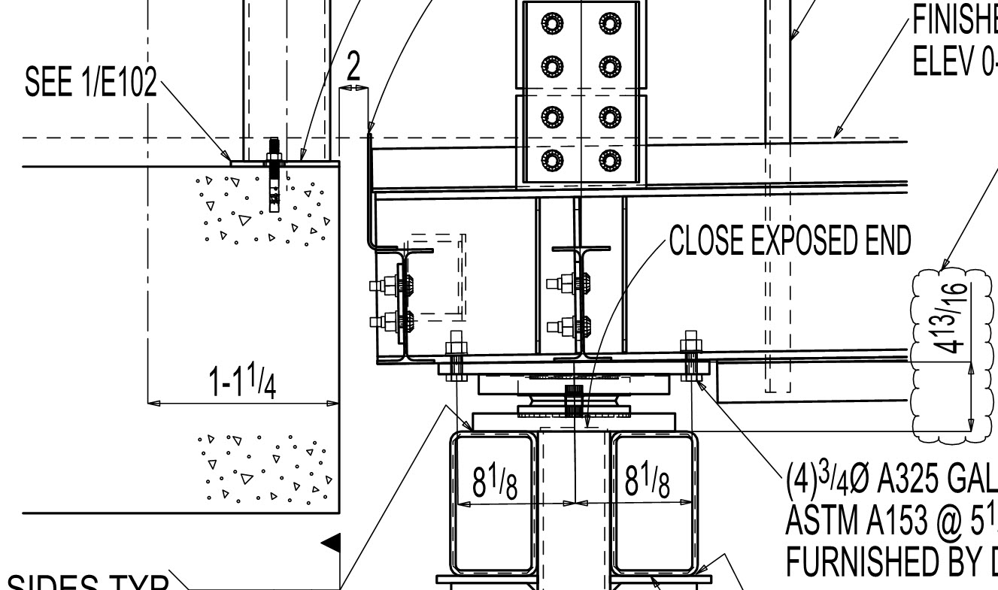
Reference Model Member Line
It can sometimes be difficult to get the polygons of a reference model to appear in an erection view created by Area Save.
The reference model “member line” needs to be in the vicinity of the area save box.

Slide 10
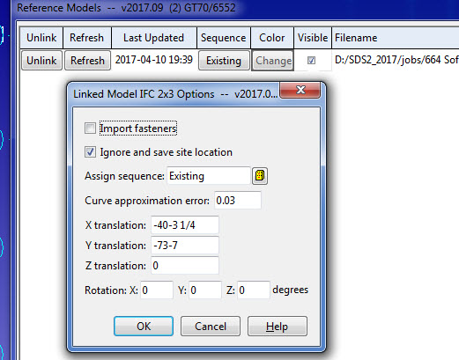
Reference Model Move/Rotate
The location of a reference model can easily be modified after import using Member Move.
The location and rotation can be modified using the Reference Model Manager – Refresh.
The offsets and rotations are accessible in the Reference Model Manager.

Slide 11
Reference Drawings
2D Reference drawings can be inserted into the SDS/2 detailing model to assist in modeling input.
Architectural and structural plans and sections
Mechanical equipment cad files for support locations
Geometry layouts

Slide 12
Reference Drawings
Reference drawings can be created from scratch in Drawing Editor.
Inserted at the current elevation and model orientation.
You can move the drawing in plan and elevation but can be awkward.
Carefully plan the saved reference point so the drawing location can easily be adjusted if needed.

Slide 13
Reference Drawings

Slide 14
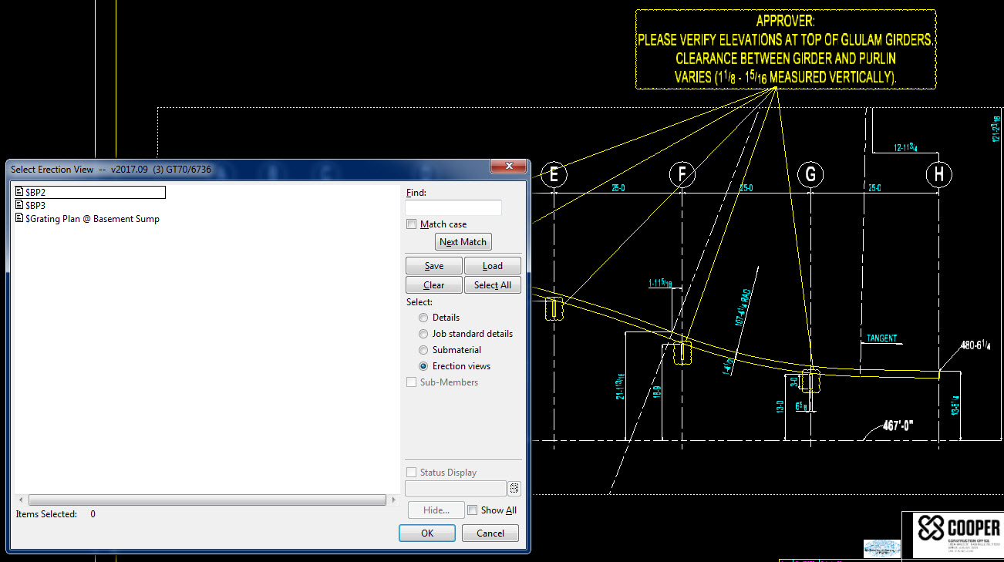
Reference Drawings
Reference drawings cannot be placed on sheets

Slide 15
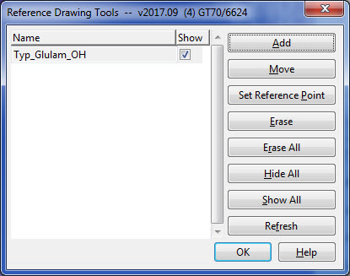
Reference Drawings
Use “Reference Drawing Tools” to manage reference drawings in the model.

Slide 16
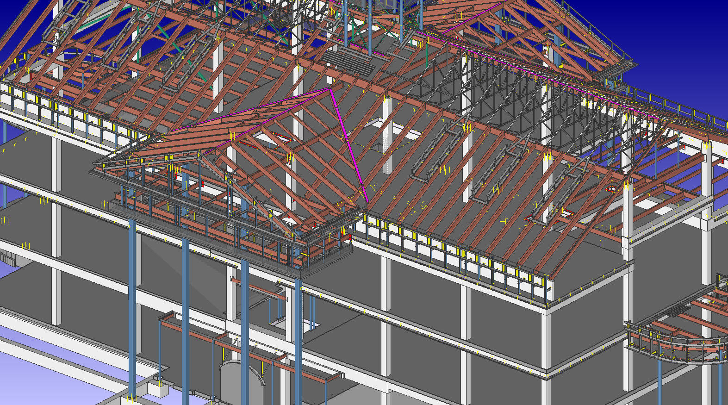
Reference Model Example
SMU project concrete reference model

Slide 17
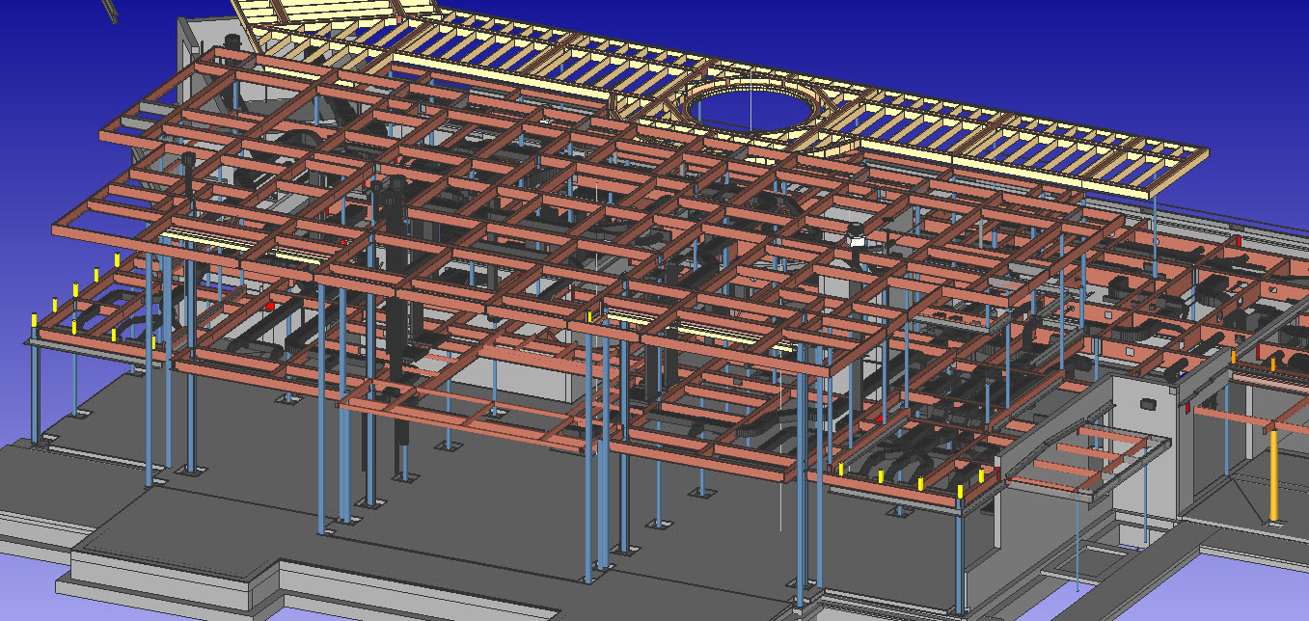
Reference Model Example
Carthage Farm concrete, structural wood, HVAC, CLT

Slide 18
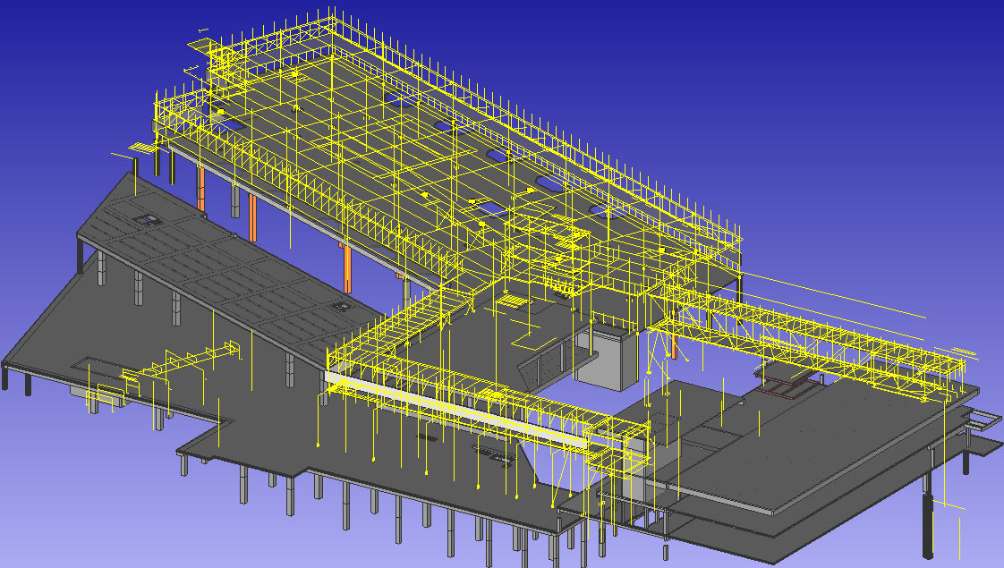
Reference Model Example
St. David’s existing concrete and survey information

Slide 19
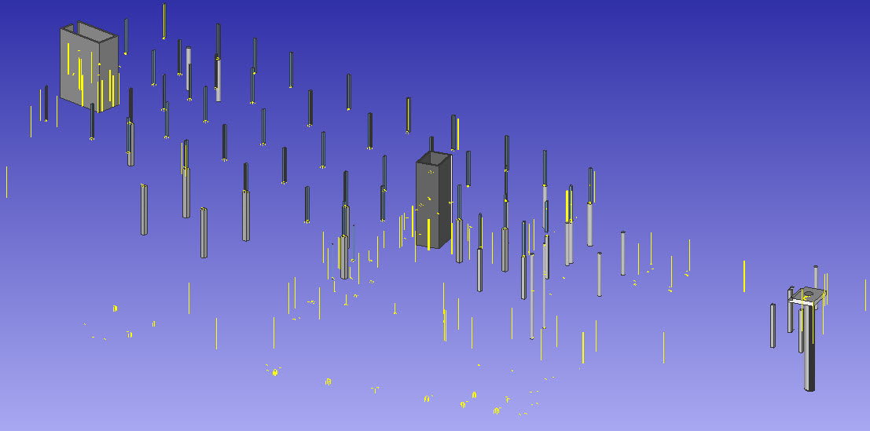
Reference Model Example
St. David’s survey data model

Slide 20
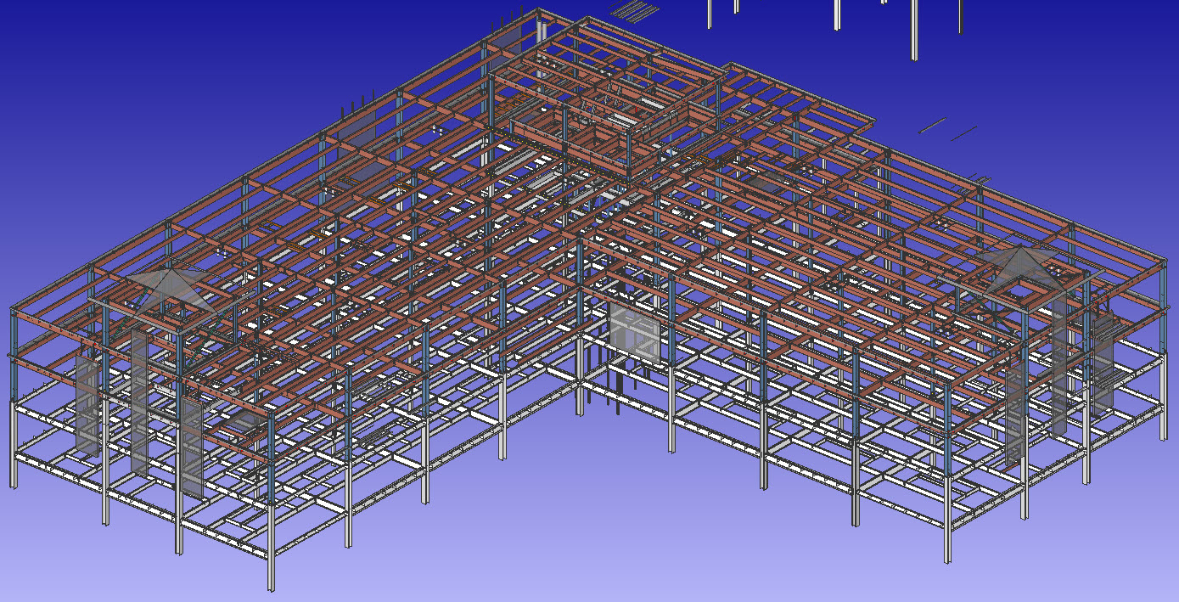
Reference Model Example
HCA Osceola existing structure from original SDS/2 model

Slide 21
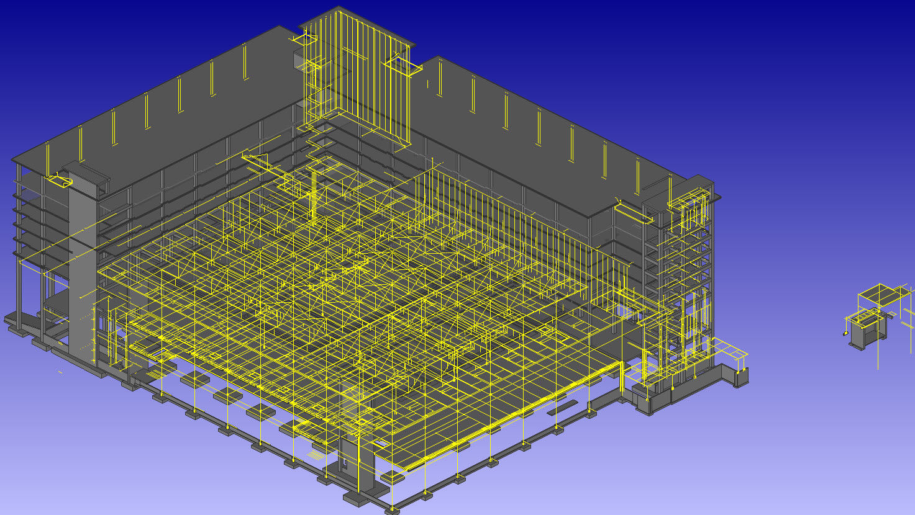
Reference Model Example
Gaylord Texan concrete

Slide 22
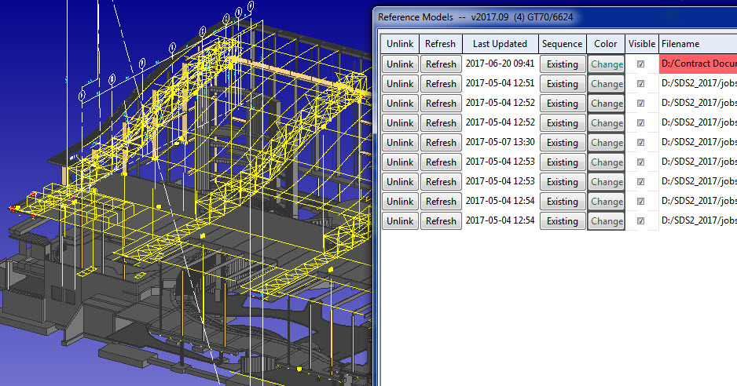
Reference Model and Drawing Example
Gaylord OWP concrete, glulams, roof geometry

Slide 23
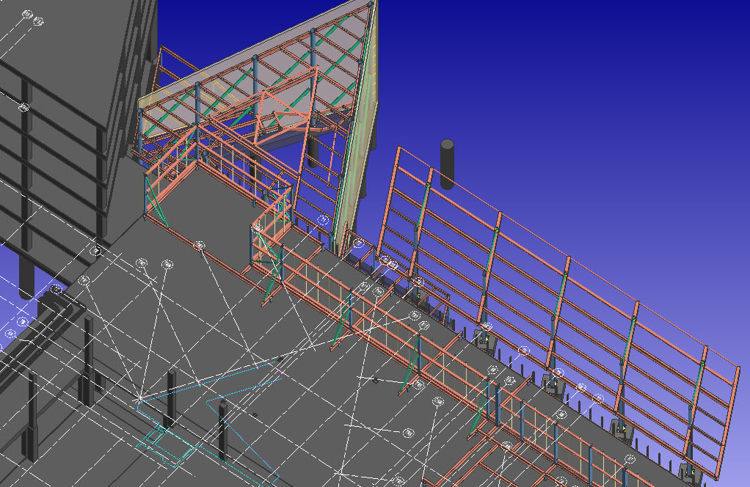
Reference Model and Drawing Example
BSWI Exterior Façade concrete, grid alignment, slab edge geometry

Slide 24
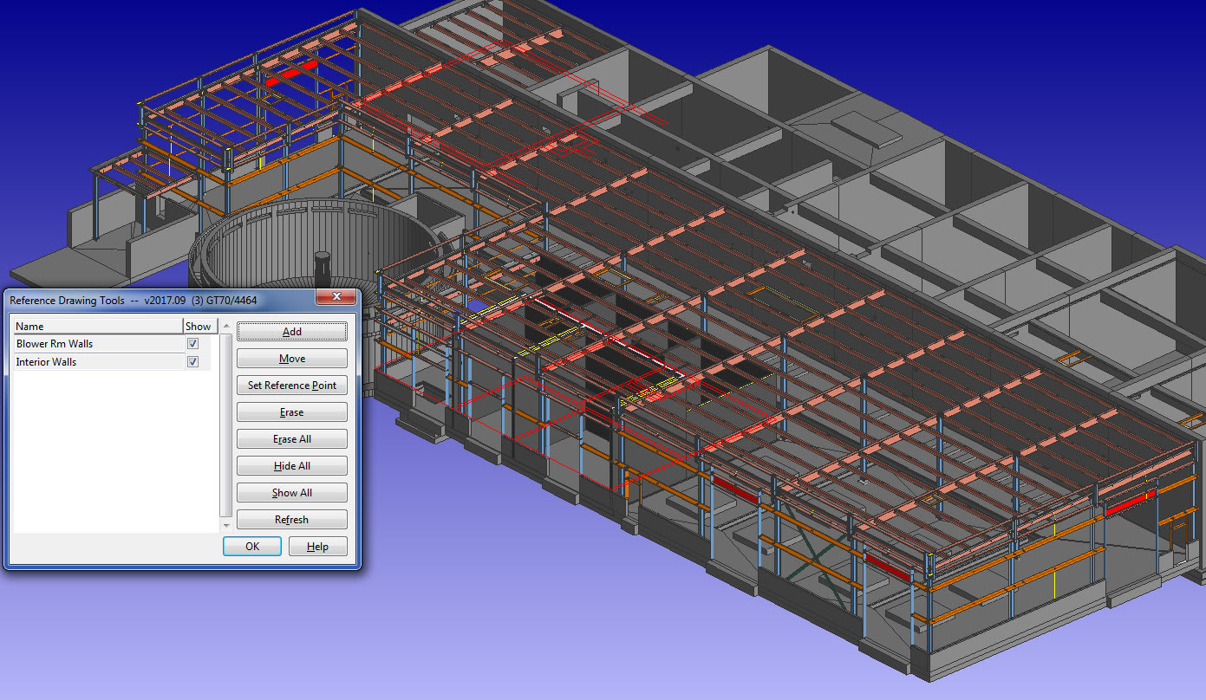
Reference Model and Drawing Example
Sofidel WWTP concrete and wall layout

Slide 25
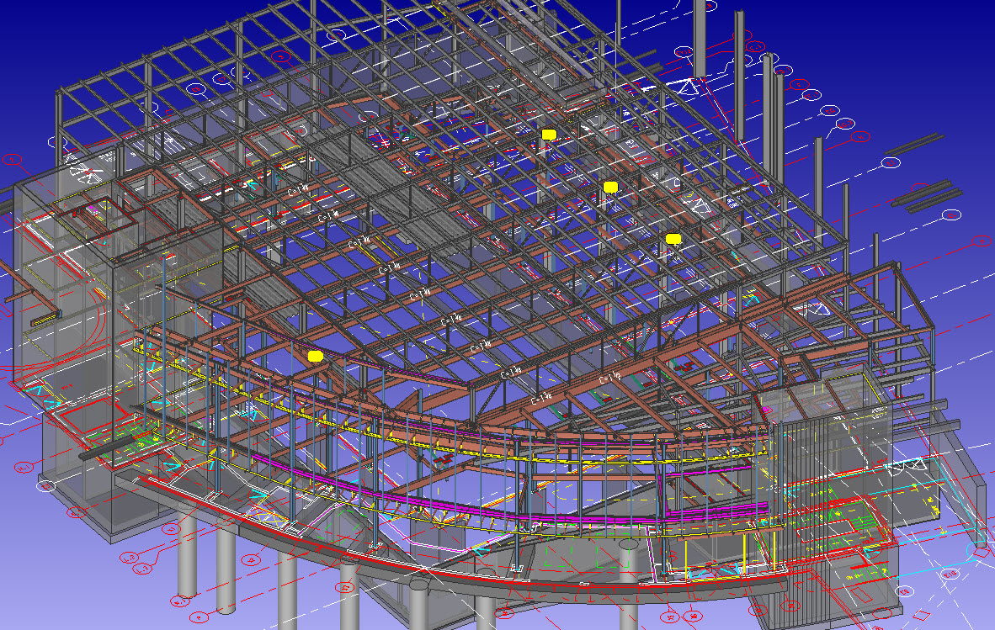
Reference Drawing Example
Hawkins Field design drawings

Slide 26
Reference Models and Drawings
For questions and comments please inquire on the SDS/2 Detailing Forum or contact Bruce Vaughan by email: bvdet@comcast.net
Thank you for attending!

