Slide 1
Project Review: Vanderbilt Residential College A
Presented by Bruce Vaughan
Thursday, September 19, 2019
11:00 – 12:20

Slide 2
Project Description
Vanderbilt University is investing $600 million in constructing four new residential colleges with a scheduled completion by 2023.
These colleges are open to sophomores, juniors, and seniors as they transition from their residential life as first-year students.
The E. Bronson Ingram College opened in August of 2018.

Slide 3
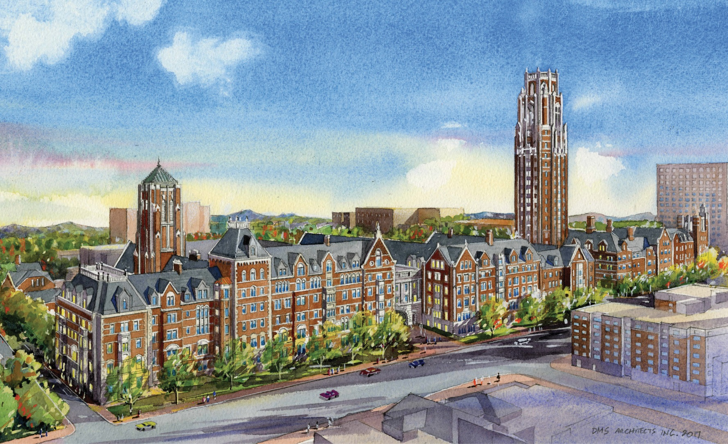
Residential Colleges A, B and C
Residential Colleges A, B and C

Slide 4
E. Bronson Ingram College

Slide 5
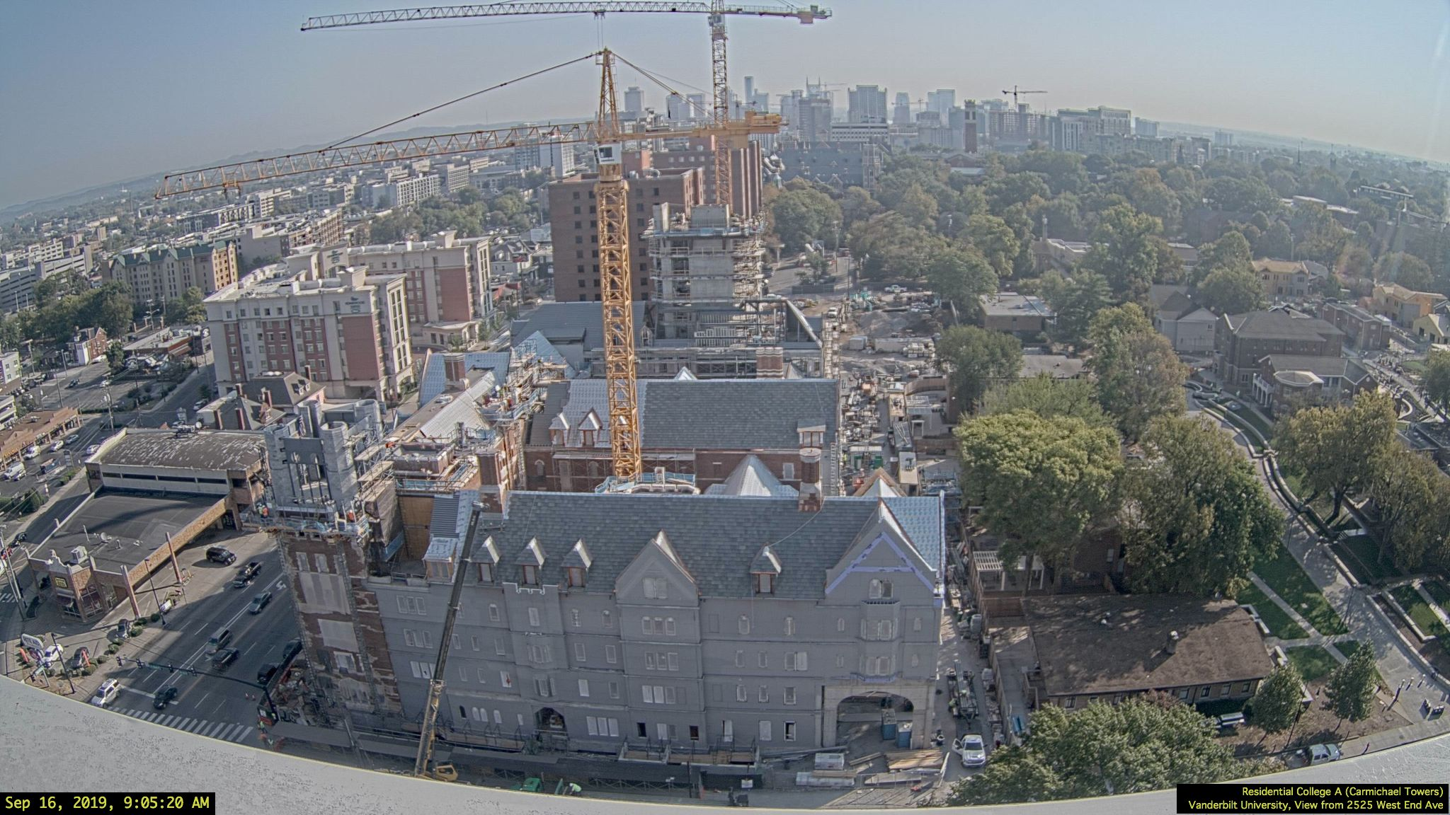
Residential College A Webcam
Project Webcam: http://webcams.vanderbilt.edu/carmichael/

Slide 6
Project Scope
The 700± ton structural project scope included:
Structural and veneer relief embeds
Areaway framing and grating
Veneer shelf and relief materials
Chimney framing
Stone support, primarily:
Stone arch supports
Parapet cap stone supports
Decorative stone panel backup structures
Roof framing

Slide 7
Project Team
Design Architect: David M. Schwarz Architects
Architect: Hastings Architecture Associates, LLC
Joint Venture Contractor:
Layton Construction
R.C. Mathews Contractor
Fabricator: Cooper Steel, Tommy Hicks PM
Detailer (Structural): BV Detailing
Detailer (Stairs): Ronnie Collins
Stone: IMS Masonry, Picco Engineering

Slide 8
BIM Collaboration
Autodesk BIM 360 Glue
Contract Documents and cad files maintained on BIM 360 Docs
Submittals managed with Primavera Submittal Exchange
Progressive IFC2x3 uploads to BIM 360 Glue

Slide 9
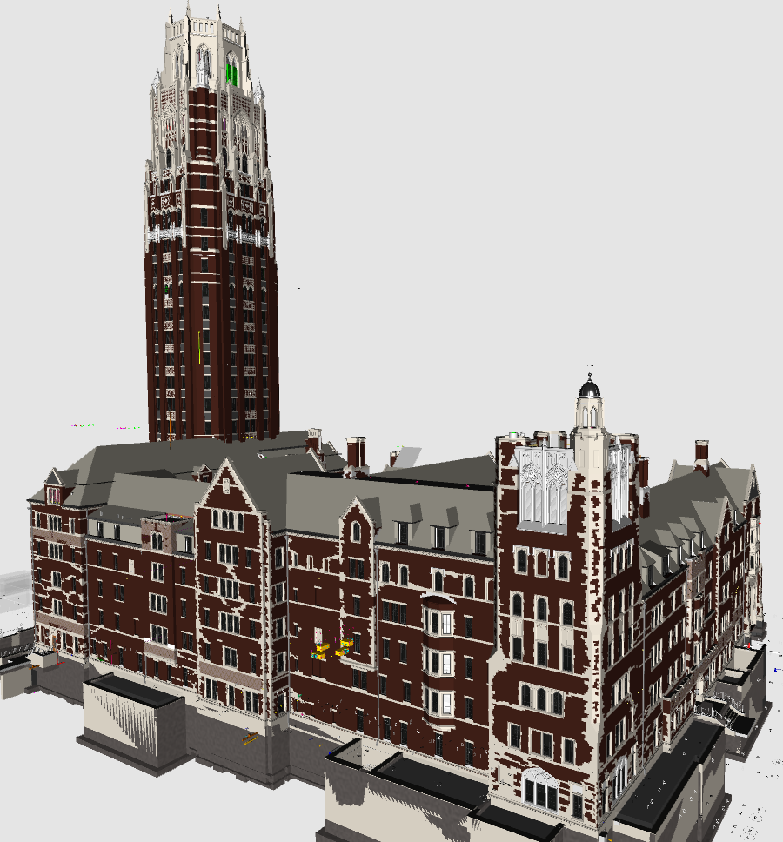
BIM Collaboration

Slide 10
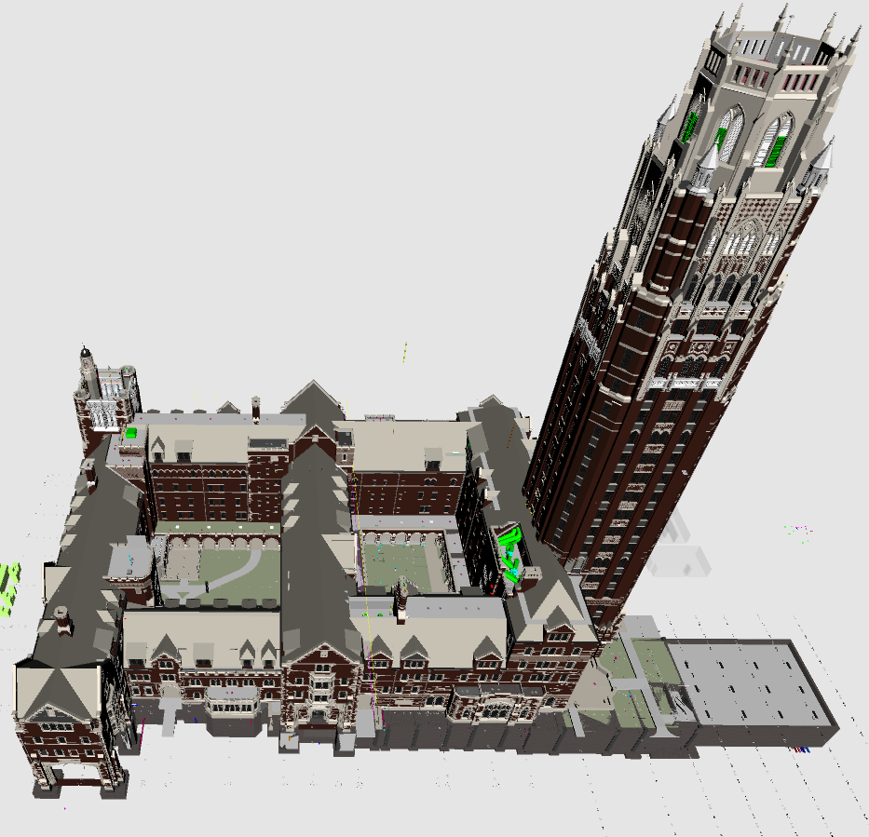
BIM Collaboration

Slide 11
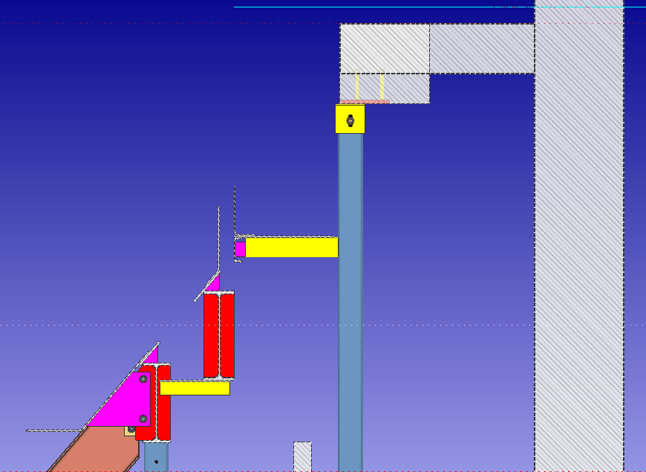
Erection Views and Sections
All sections and details are taken from the model as part of quality assurance

Slide 12
Erection Views and Sections

Slide 13
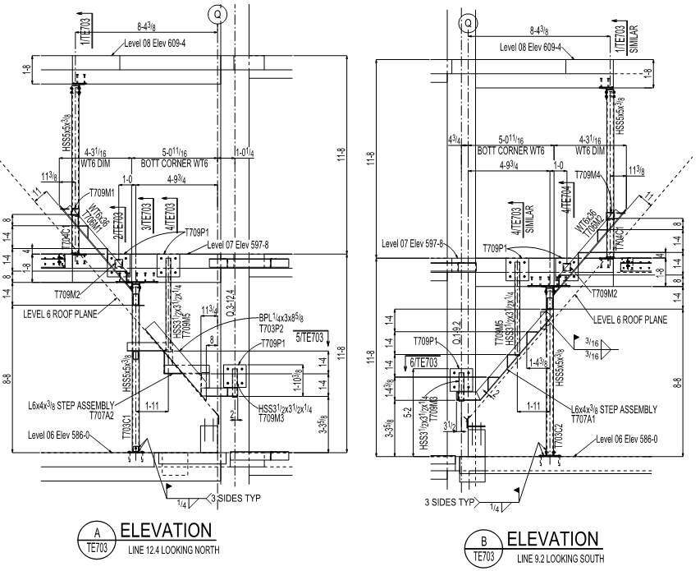
Erection Views and Sections

Slide 14
Reference Models
Architectural Slabs
Structural Design Model
Concrete Model

Slide 15
Reference Drawings
60+ reference drawings were imported or created to ensure quality
Stone gables
Stone parapets
Stone panels
Veneer plans
Courtyard stair
Northwest tower

Slide 16
Custom Members
EmbedPL
EmbedAngle
ConcFtgCol
RoofFrame
BentPL (Pour Stop)
Concrete Slab and Wall

Slide 17
Components
Rat Hole
EndBevelCut
Surfaces connection
Outrigger
Beam Stiffener
Void space layout

Slide 18
Parametrics/Plugins
Drawing_Mem_Select_On_Sheets.py
Drawing_Model_Submaterial_Marks_From_MemberMks.py
ConsArrayPolar.py
ConsArrayLinear.py
ConsCircle3P.py
Model Bolts
View 1
View XYZ
Iso
SagRodTool

Slide 19
Parametrics/Plugins
Plate Washer Tool
Beam_Stiff.py
Beam_ShearTab.py
Beam_Clips.py
Col_ErectSeat.py
Model_L10_by_members.py
strip_Winzip_text.py
StudCount_Cust_Prop.py
Others

Slide 20
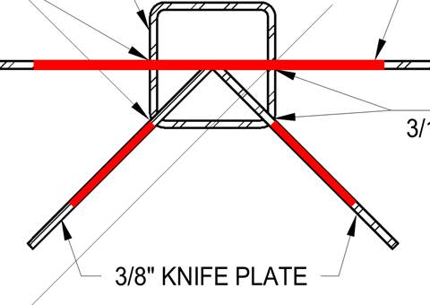
Construction Details
Shear tabs were used throughout except at chimney support platforms.
Thru-plate shear tabs to HSS columns were eliminated except at certain specific details.

Slide 21
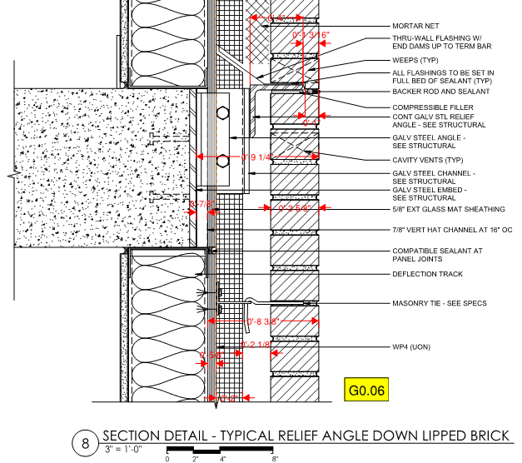
Construction Details
Typical exterior veneer detail used throughout the project

Slide 22
Typical Connections and Plan Notes

Slide 23
Typical Connections and Plan Notes

Slide 24
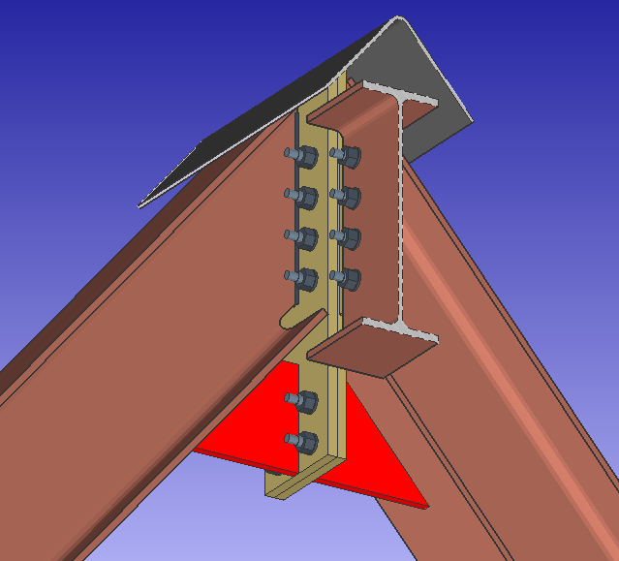
Bent Peak Connection

Slide 25
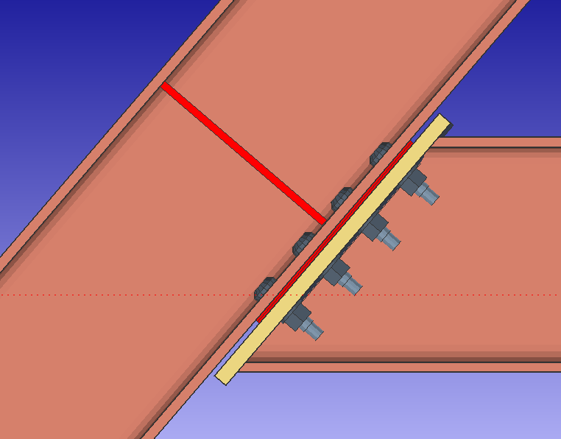
Bent Strut Connection

Slide 26
Roof Connections

Slide 27
Roof Connections

Slide 28
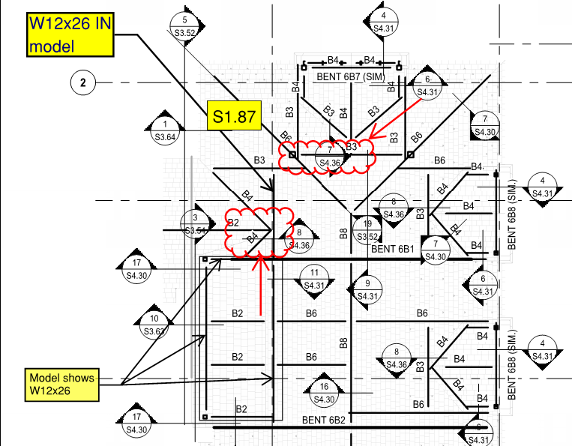
Head Scratcher

Slide 29
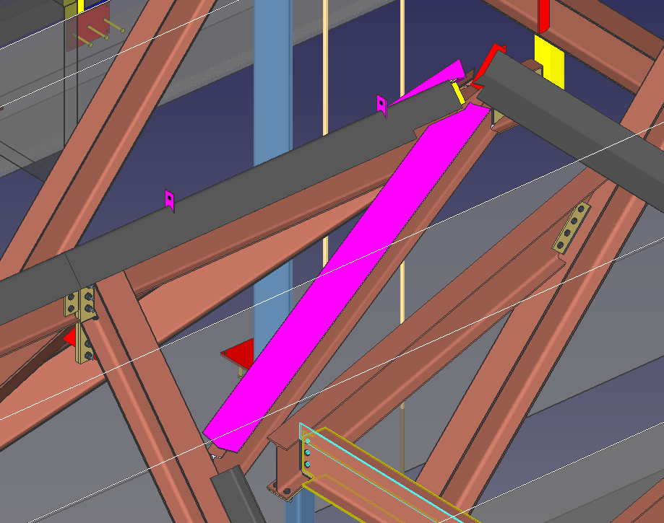
Head Scratcher

Slide 30
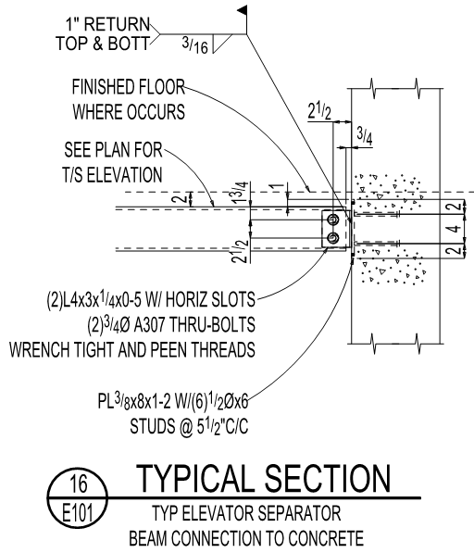
Elevator Divider Connection

Slide 31
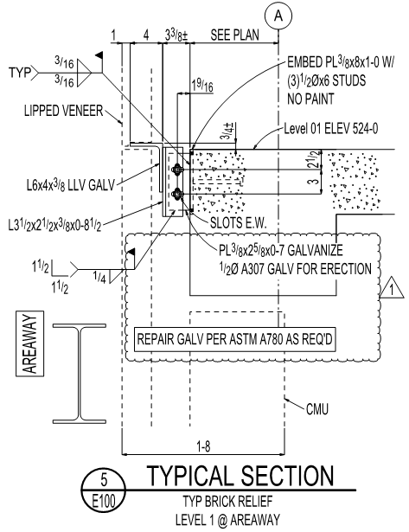
Relief/Shelf Angle Details

Slide 32
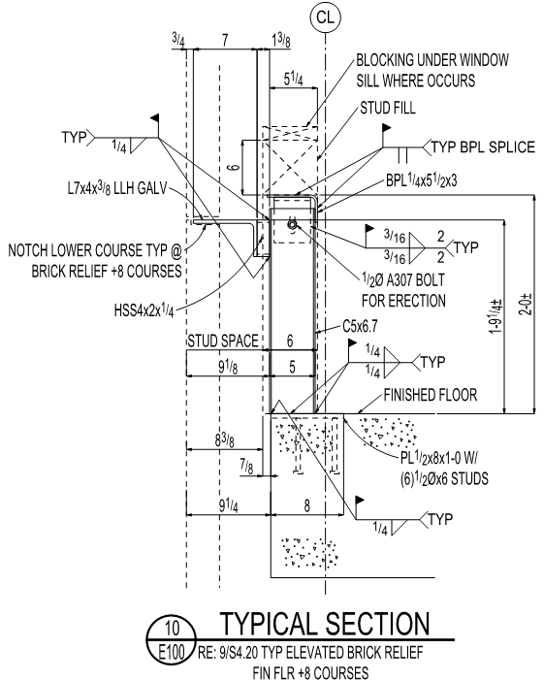
Relief/Shelf Angle Details

Slide 33
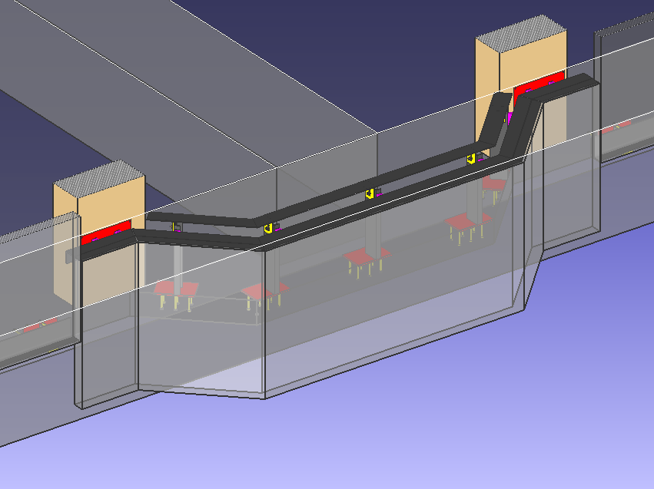
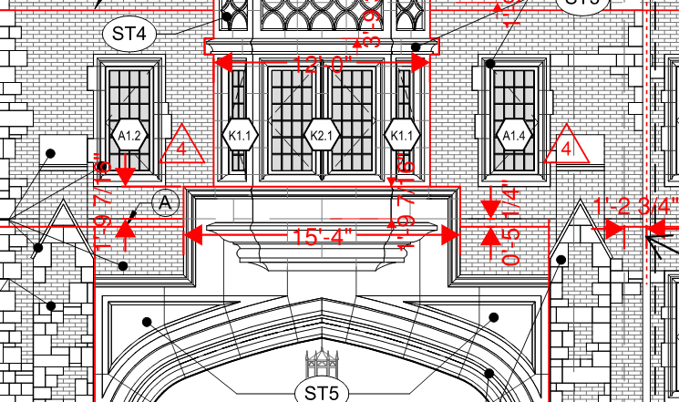
Relief/Shelf Angle Details
Much of the elevated relief angle was eliminated and typical relief was used through VE.

Slide 34
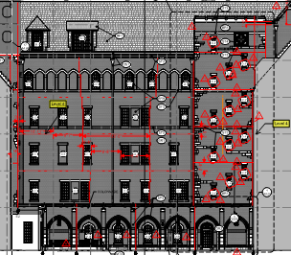
Relief Angle @ Control Joints
Originally relief angles were required to break at masonry control joints.
Due to difficulty of aligning joints in the field, the EOR reviewed this requirement and decided it was unnecessary.

Slide 35
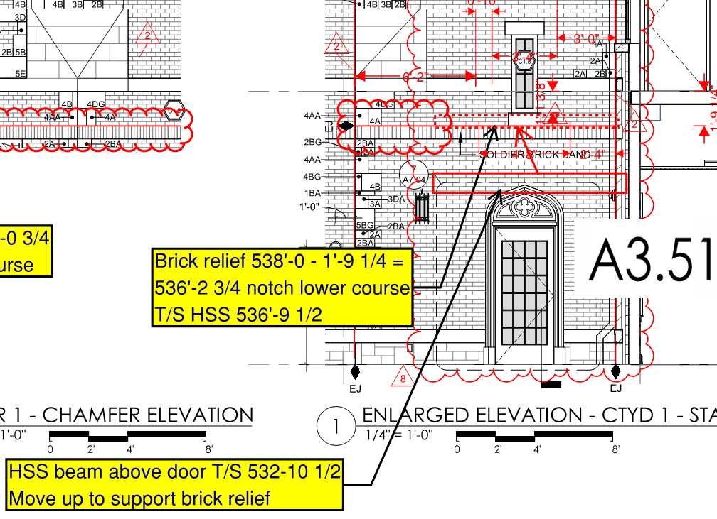
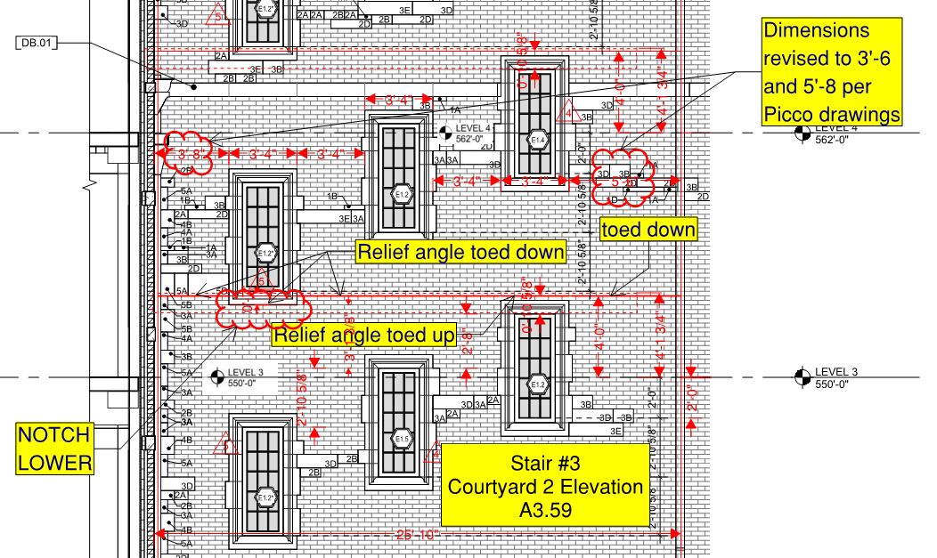
Stair Enclosures
Bluebeam was used to document structure and relief requirements

Slide 36
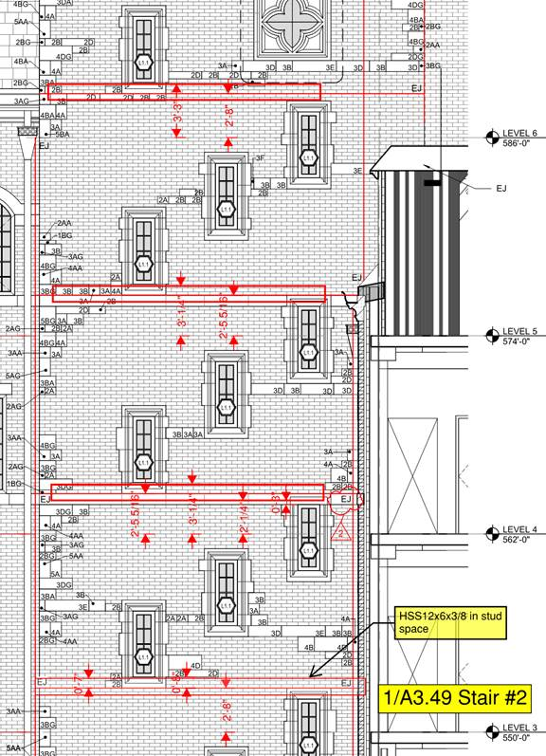
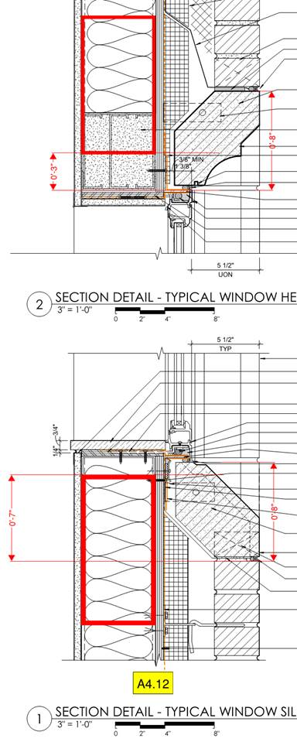
Stair Enclosures

Slide 37
Stair Enclosures
Structure is required to be fireproofed.
Framing in stud cavity is shop primed compatible with intumescent paint.

Slide 38
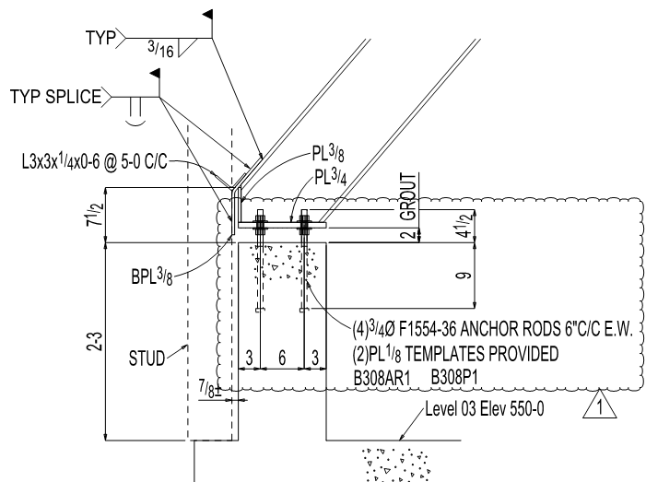
Typical Roof Edge Condition
Edge condition is consistent throughout

Slide 39
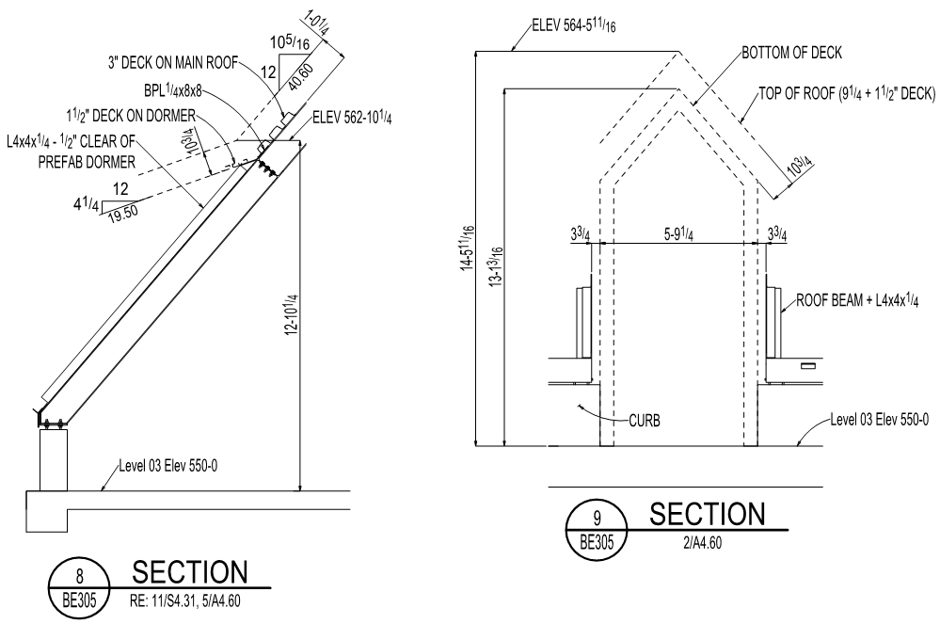
Typical Gable and Shed Dormers

Slide 40
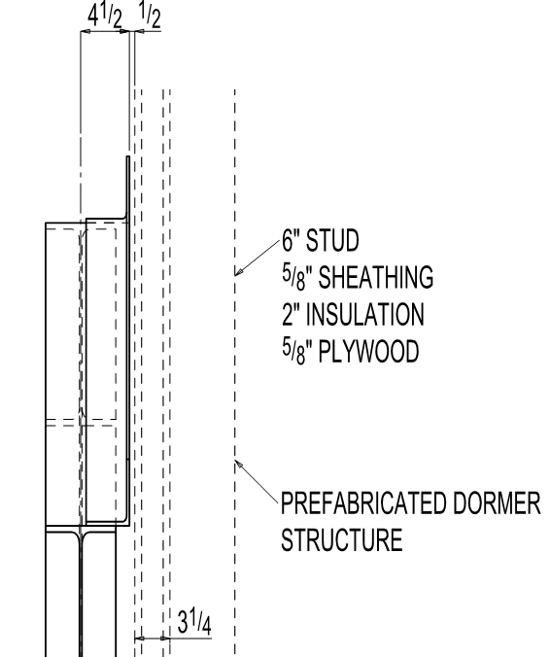
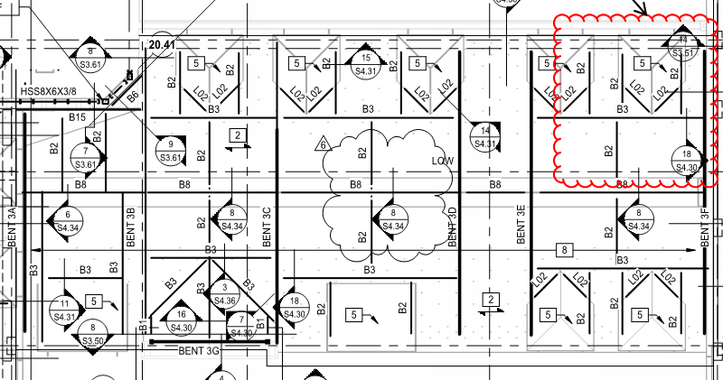
Typical Gable and Shed Dormers

Slide 41
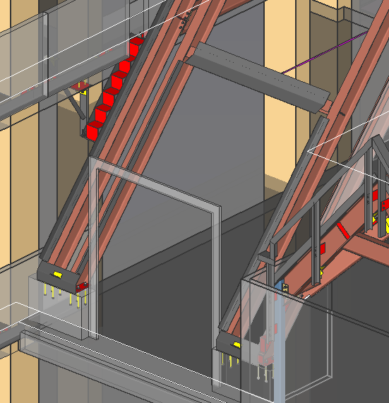
Typical Gable and Shed Dormers
Shed dormer adjacent to framed dormer and veneer step assembly

Slide 42
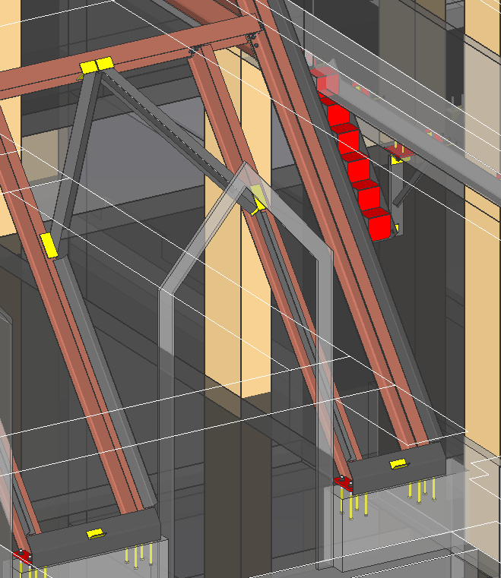
Typical Gable and Shed Dormers
Gable dormer adjacent to veneer step assembly

Slide 43
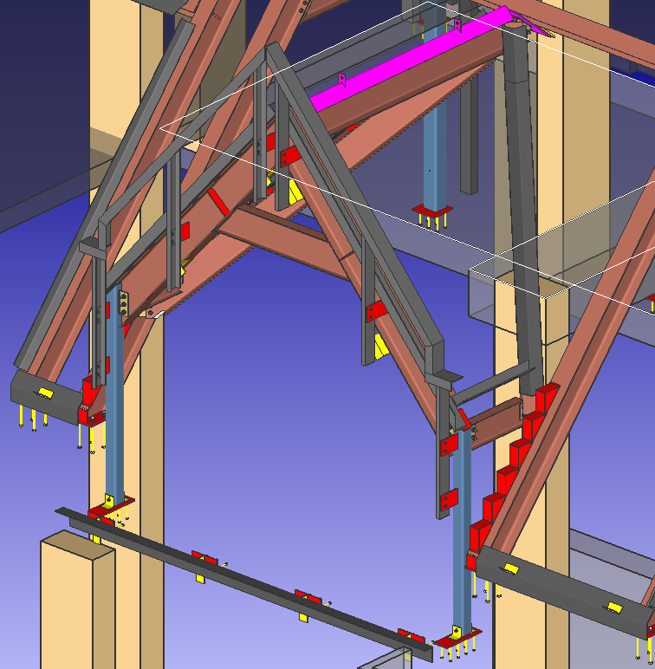
Framed Dormers
Typically consists of:
exterior posts and bent
ridge and valley beams
beams in stud cavity
deck edge angle
gable frame
veneer step assembly

Slide 44
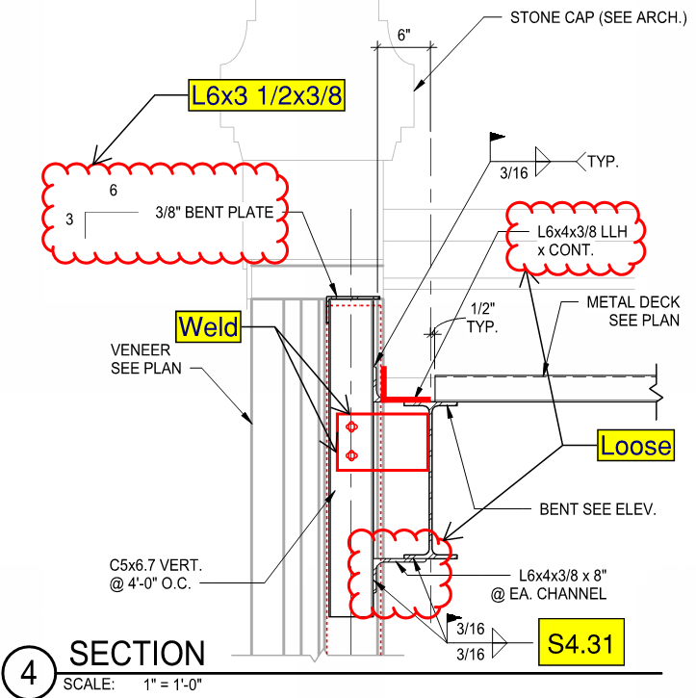
Framed Dormers

Slide 45
Gable Parapet and Stone Supports
Picco provided DWG of stone profiles and annotated design drawing PDFs for gable cap stone.
Reference drawings were created from the profiles.
The reference drawings were used in combination with architectural elevations for modeling and shop drawings.

Slide 46
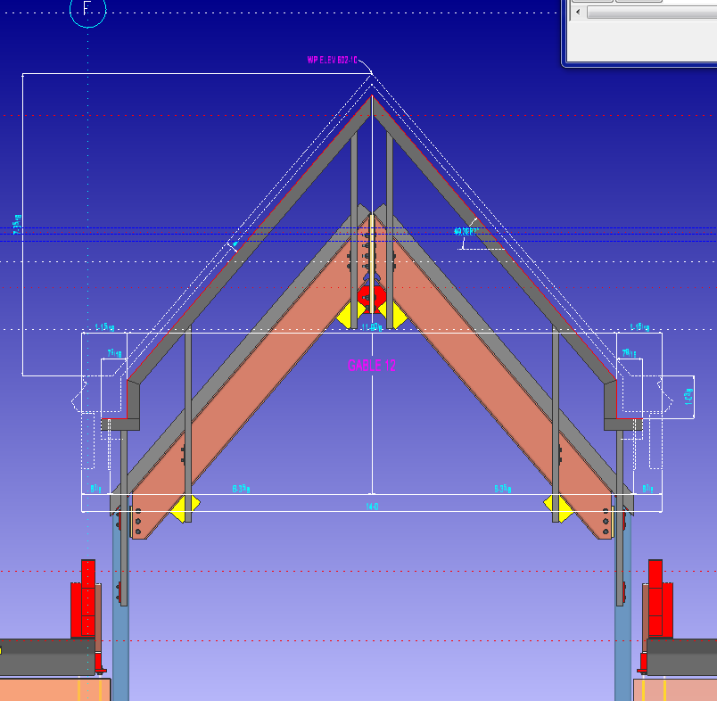
Example Gable

Slide 47
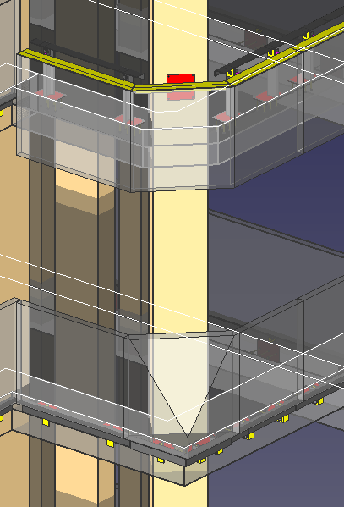
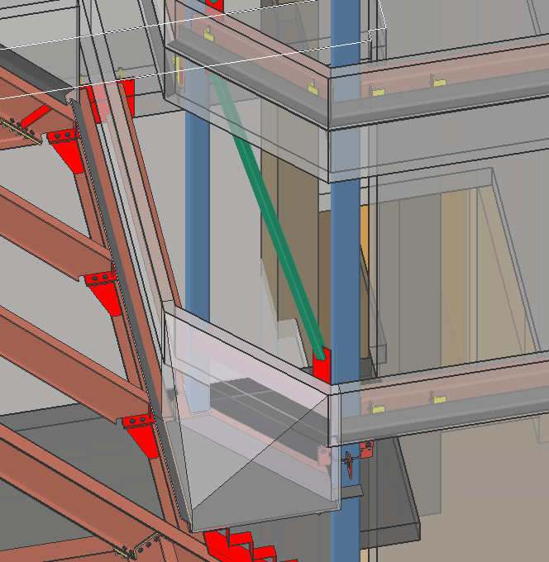
Chamfer Stone

Slide 48
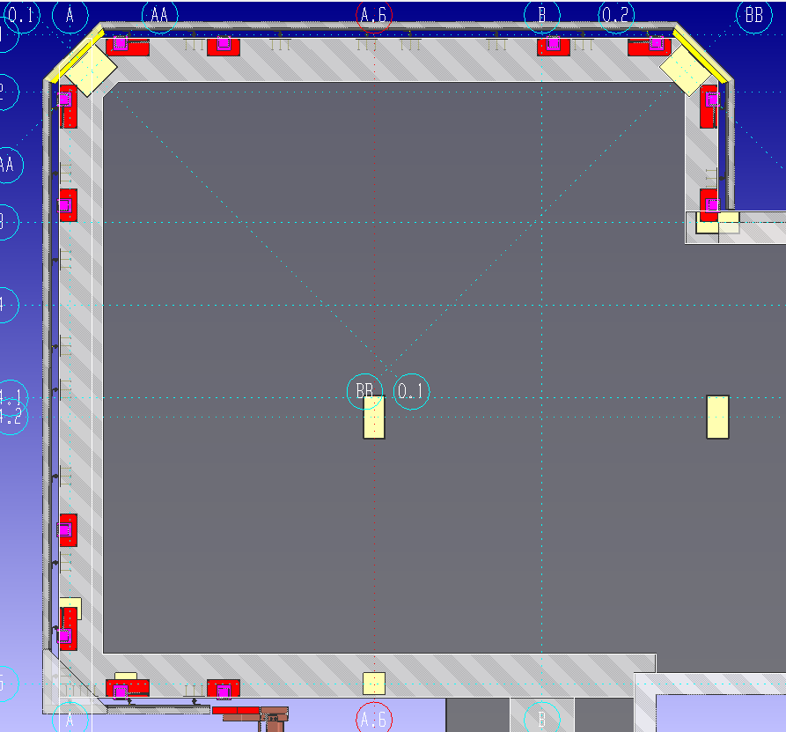
NW Tower

Slide 49
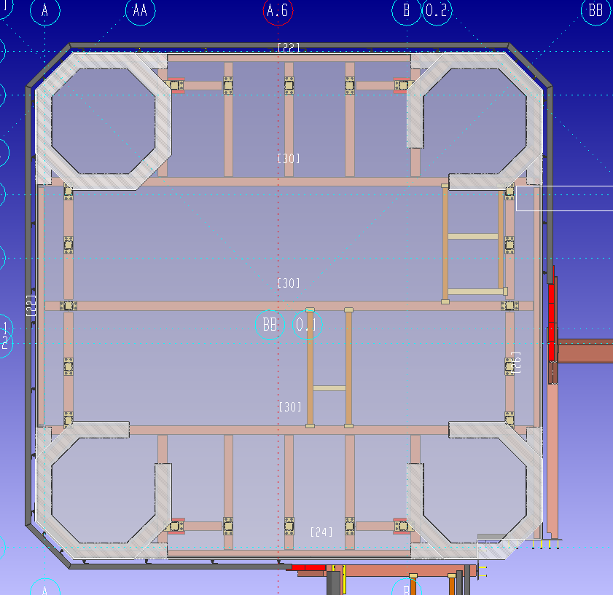
NW Tower

Slide 50
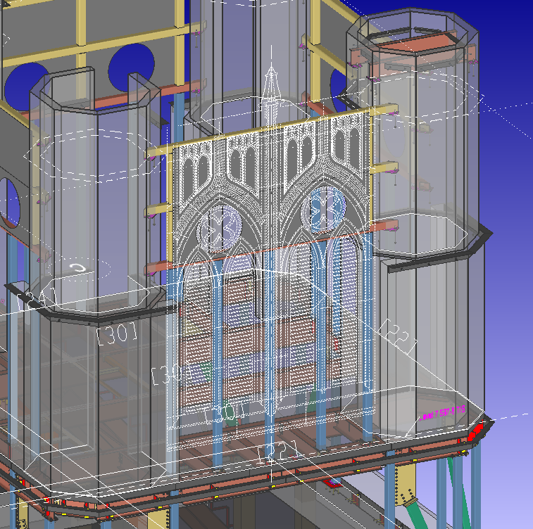
NW Tower

Slide 51
NW Tower

Slide 52
NW Tower

Slide 53
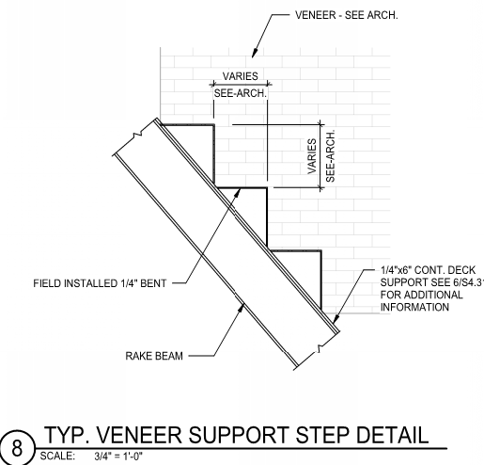
Veneer Step Assemblies
Design Detail

Slide 54
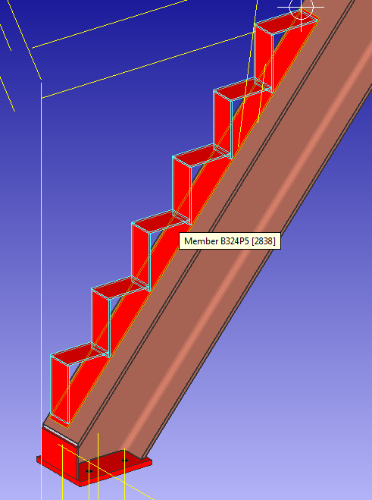
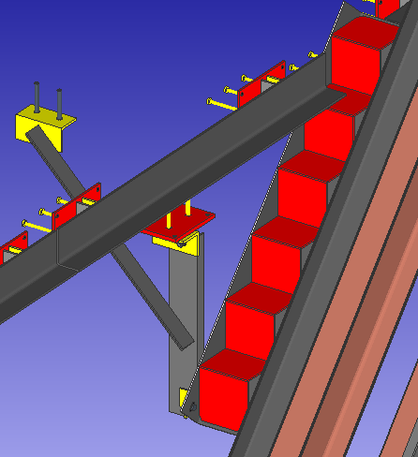
Veneer Step Assemblies

Slide 55
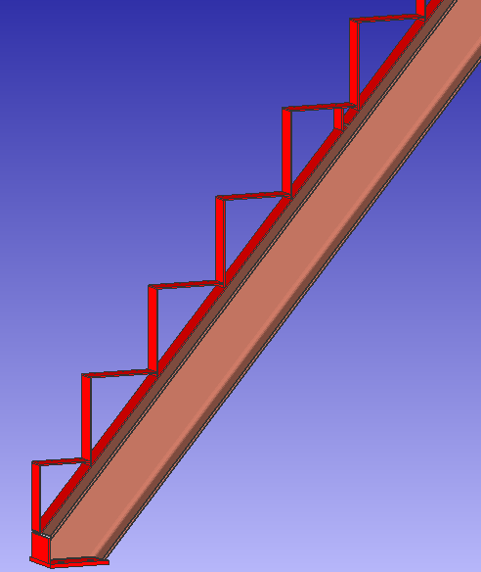
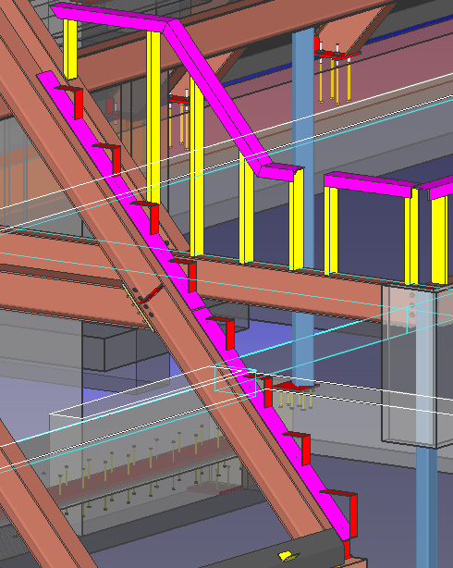
Veneer Step Assemblies

Slide 56
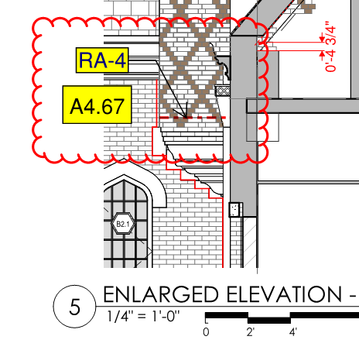
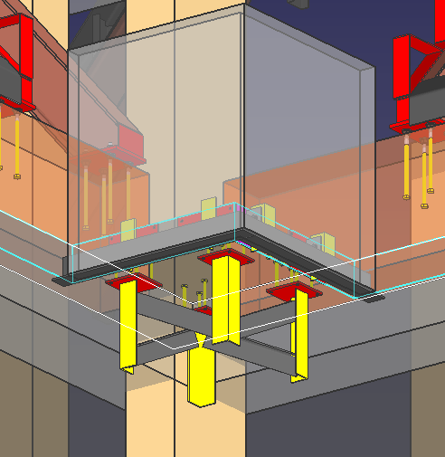
Courtyard #2 Turret

Slide 57
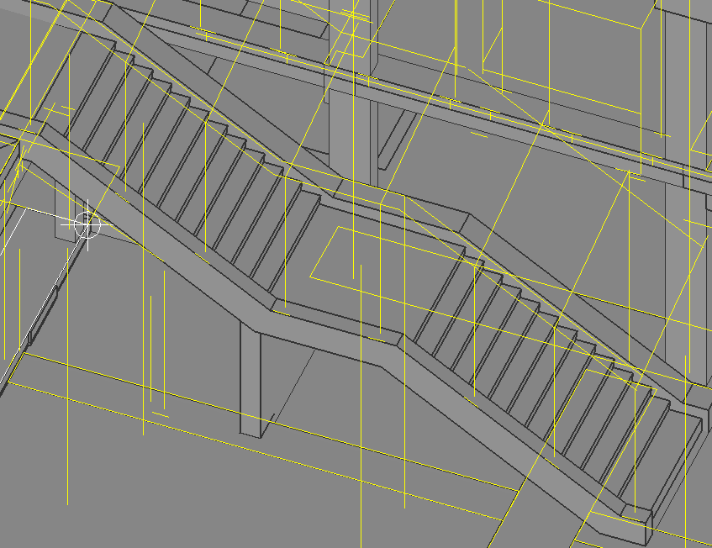
Courtyard #2 Stair

Slide 58
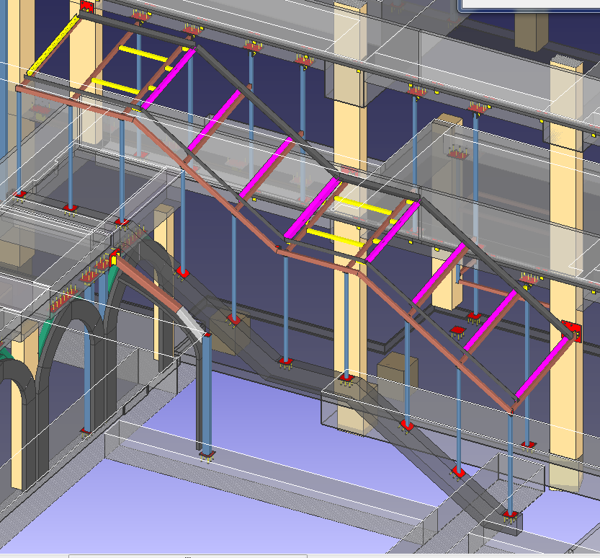
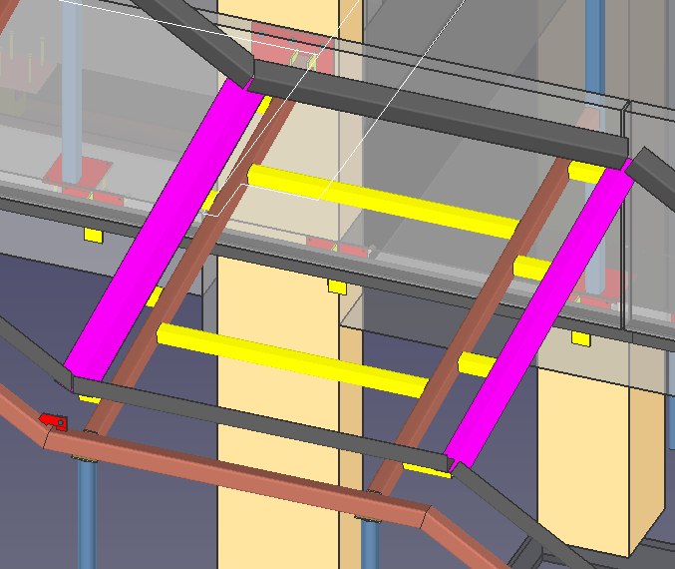
Courtyard #2 Stair

Slide 59
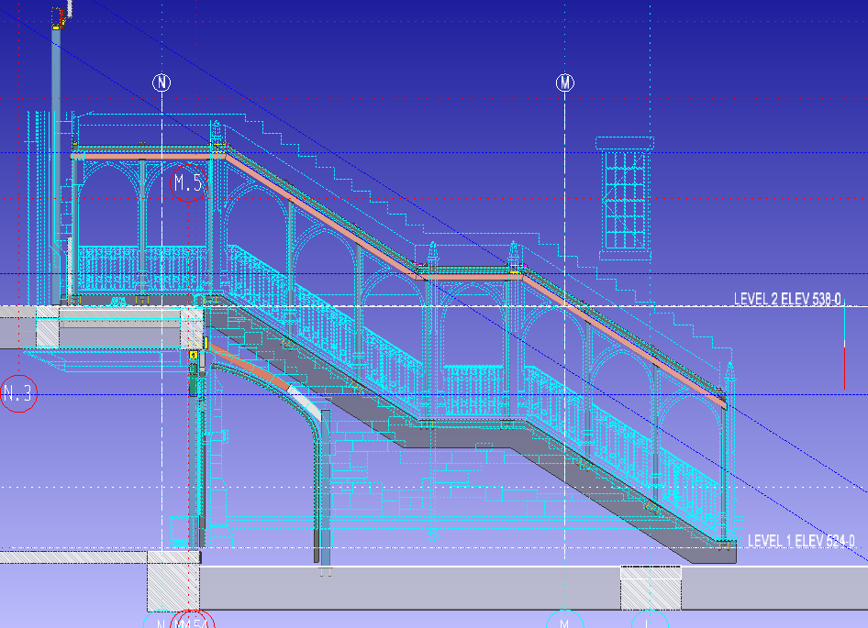
Courtyard #2 Stair

Slide 60
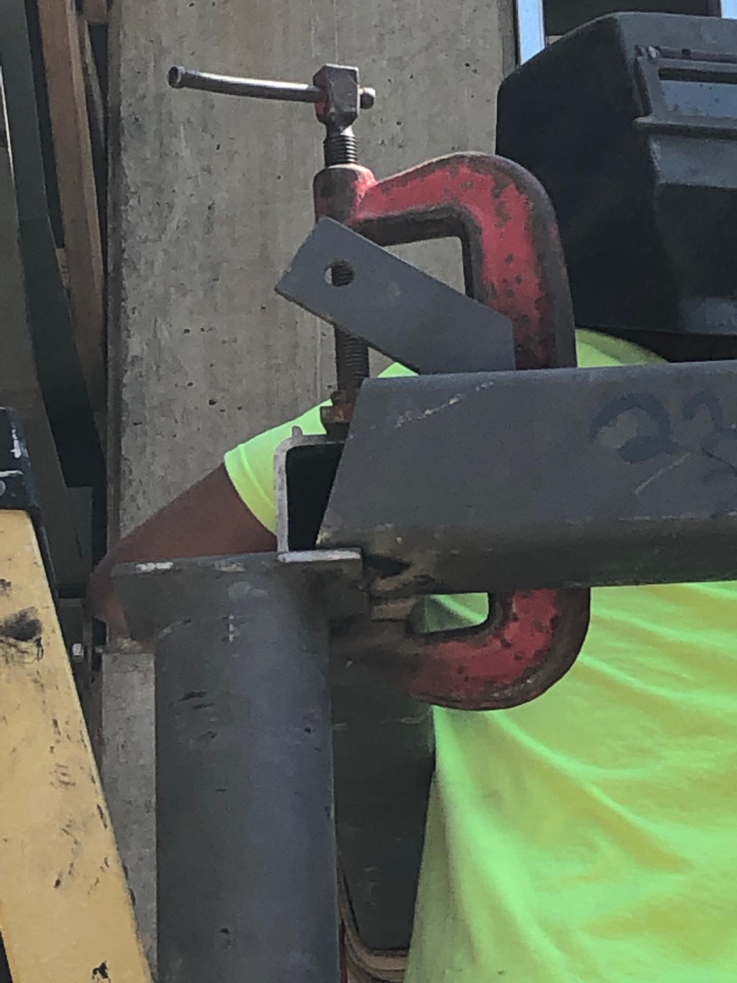
Courtyard #2 Stair
Oops

Slide 61
Chimneys
Chimneys are not functional
Some chimneys were deleted during TVD
Chimney steel structures and masonry were assembled in the courtyards and erected in lifts
Lessons learned during Bronson construction

Slide 62
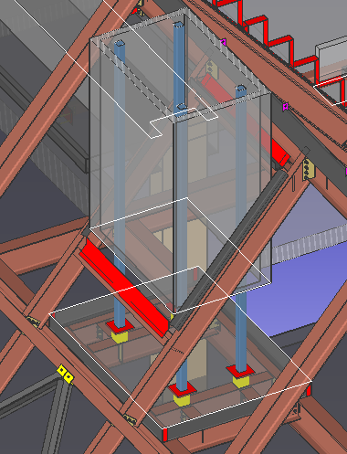
Chimneys

Slide 63
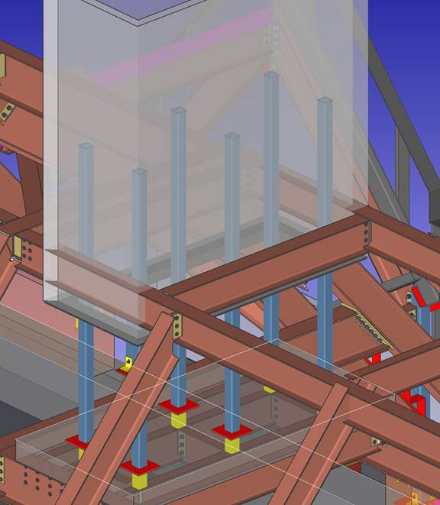
Chimneys

Slide 64
Chimneys

Slide 65
Concrete Roof Curbs
Roof curb dimensions were coordinated with structural, architectural and concrete line drawings. Heights were 2’-3 and 1’-7.

Slide 66
Stone Capped Parapets
Architectural, structural and stone requirements were coordinated

Slide 67
Stone Arches
Miscellaneous member elements were added to the model to establish support members for stone arches.

Slide 68
Stone Arches

Slide 69
Stone Arches

Slide 70
North Corbel
Post installation of veneer shelf and stone support

Slide 71
Stair #7 and Elevator Roof Parapets

Slide 72
Stair #4 Roof and Mechanical Well

Slide 73
East Tower Portico

Slide 74
East Tower Portico

Slide 75
Dining Room South

Slide 76
Dining Room East

Slide 77
Stair #1 Braced Frames
Group Member
Member with copied material (legacy)

Slide 78
Veneer Dimension Coordinaton

Slide 79
Veneer Dimension Coordinaton

Slide 80
Structure Coordinaton

Slide 81
Odd Connection

Slide 82
Odd Connection

Slide 83
Odd Connection

Slide 84
Tower and Level 6 Roof Interface

Slide 85
Tower and Level 6 Roof Interface

Slide 86
Tower and Level 6 Roof Interface

Slide 87
Tower and Level 6 Roof Interface

Slide 88
East Shear Wall Corbels

Slide 89
Vanderbilt Residential College A
For questions and comments please inquire on the SDS/2 Detailing Forum or contact Bruce Vaughan by email: bvdet@comcast.net
Thank you for attending!

