Slide 1
v2017 Feature Review (Part 1)
Speaker: Matt Bailey P.E.

Slide 2
Purpose
What have you missed?
Are you using all the tools?

Slide 3
What’s New?
How do you know?

Slide 4
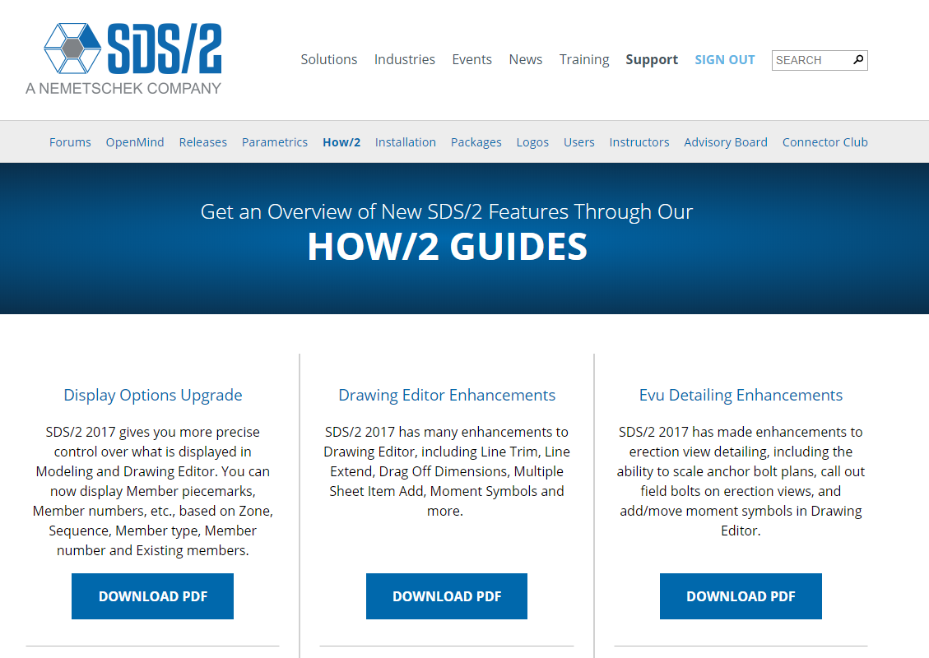
What’s New?
How/2 on SDS2.com

Slide 5
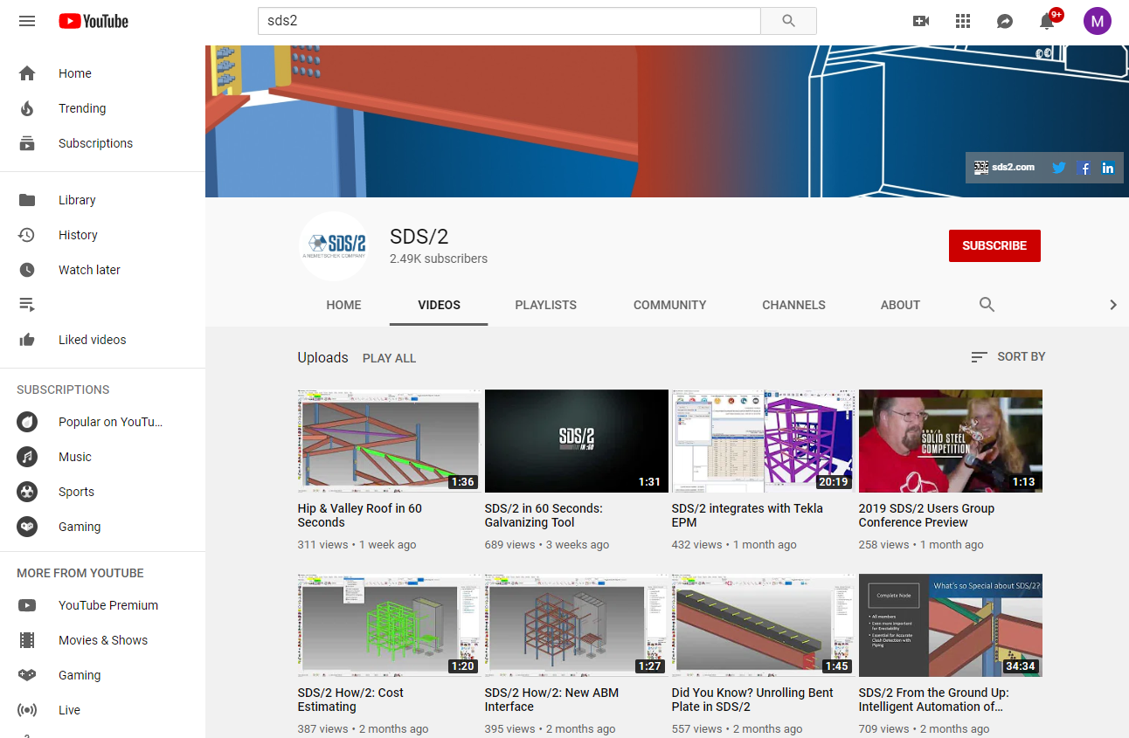
What’s New?
YouTube New/2 Video on SDS/2 Channel

Slide 6
What’s New?
Release Notes Website
https://sds2.com/support/release_notes.php

Slide 7
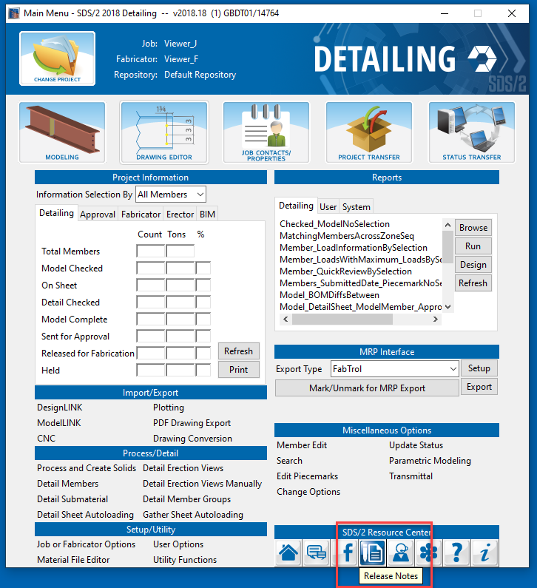
What’s New?
Release Notes from Main Menu

Slide 8
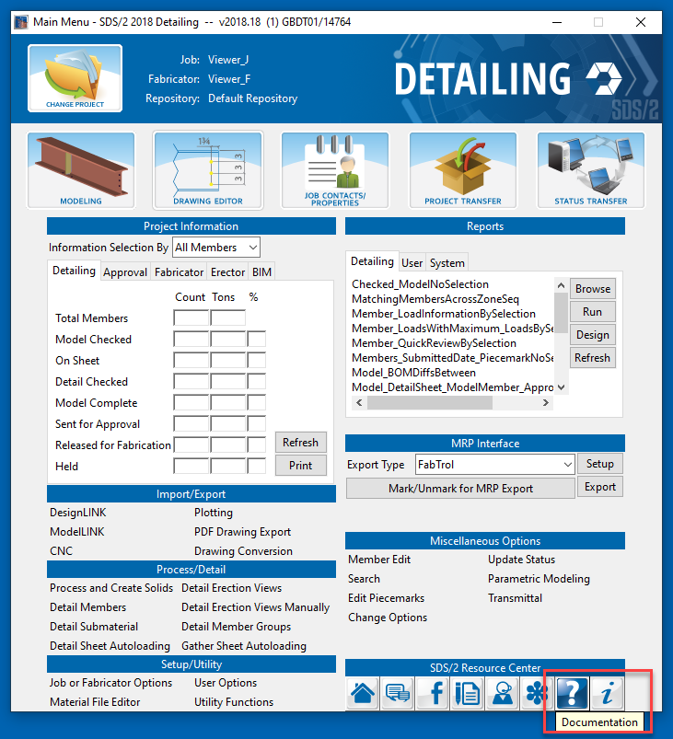
What’s New?
Documentation

Slide 9
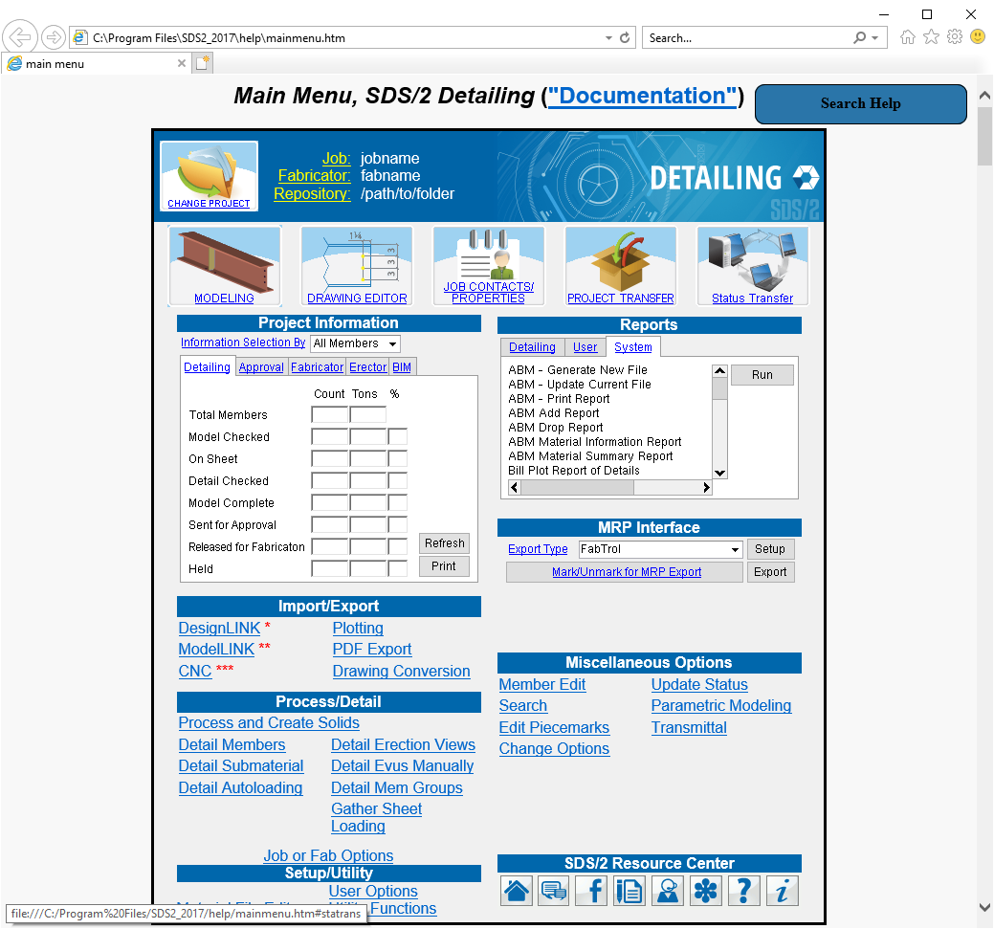
What’s New?
Documentation
Search Added to Help Documentation

Slide 10
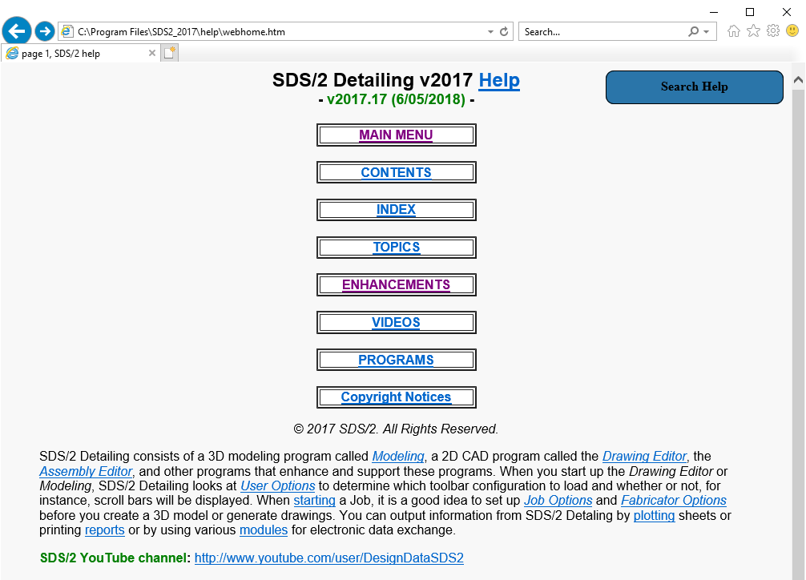
What’s New?
Documentation

Slide 11
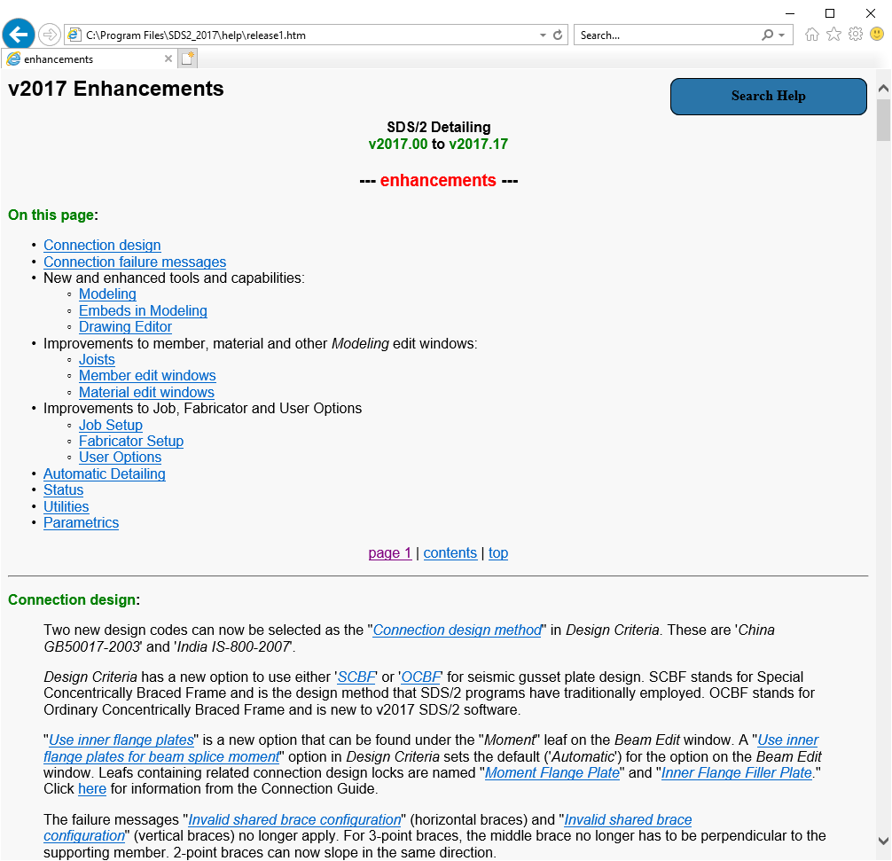
What’s New?
Documentation
New

Slide 12
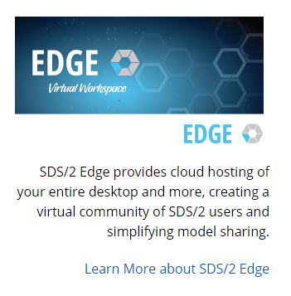
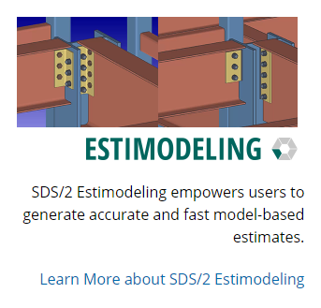
What’s New?
SDS/2 Website

Slide 13
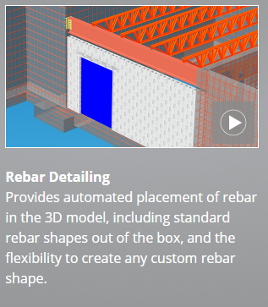
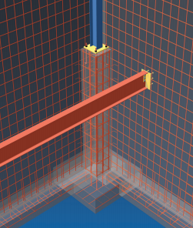
SDS/2 Concrete
v2017

Slide 14
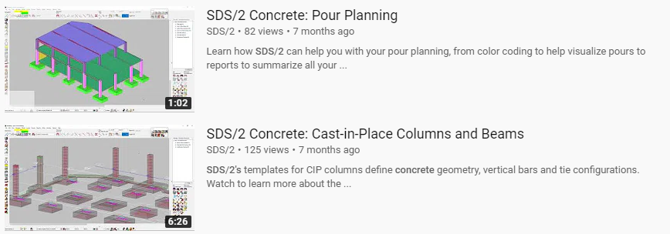
SDS/2 Concrete
v2017
Thursday 8:00 am Session
YouTube

Slide 15
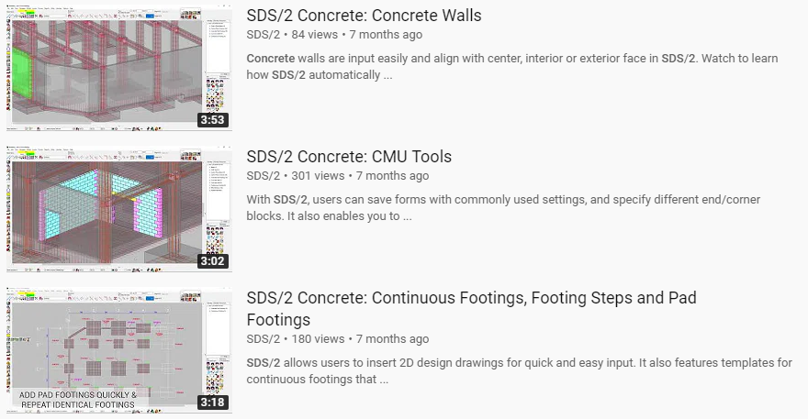
SDS/2 Concrete
v2017
YouTube

Slide 16
SDS/2 Concrete
v2017
YouTube

Slide 17
SDS/2 Concrete
v2017
YouTube

Slide 18
SDS/2 Concrete
v2017
YouTube

Slide 19
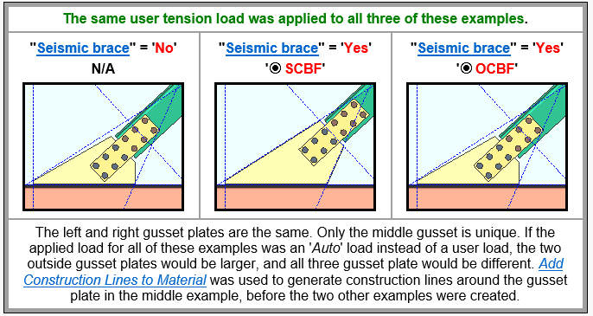
Design Criteria
v2017
Design Criteria has a new option to use either 'SCBF' or 'OCBF' for seismic gusset plate design.

Slide 20
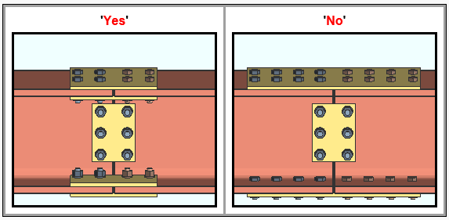
Beam Splice – Inner Flange Plates
v2017
Bolted Moment Beam Splice
Modify using Design Locks

Slide 21
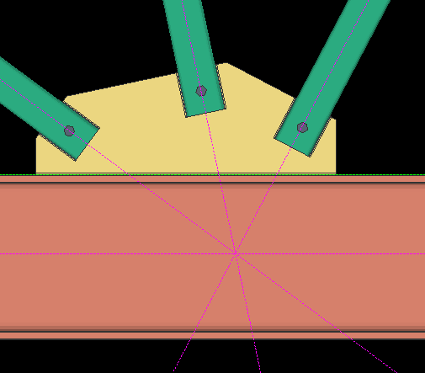
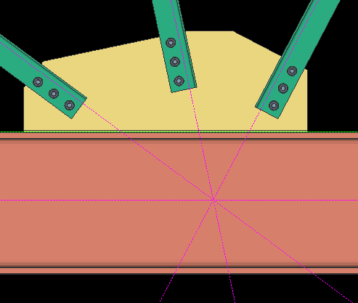
3 Point Gusset Plate
v2017
Shared Gusset Plate does not need Middle Brace perpendicular to beam.

Slide 22
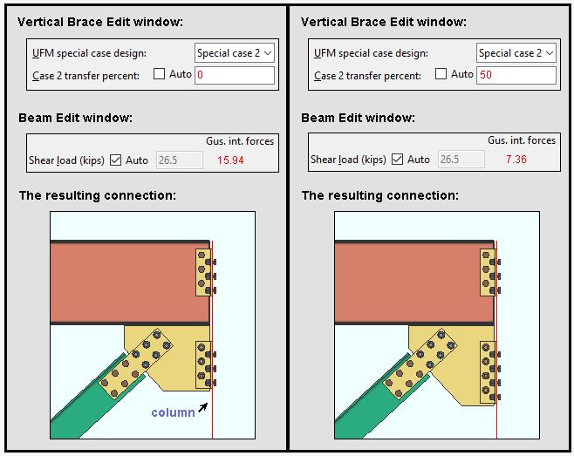
Uniform Force Method
v2017
Special Case 2 – Percent Transfer

Slide 23
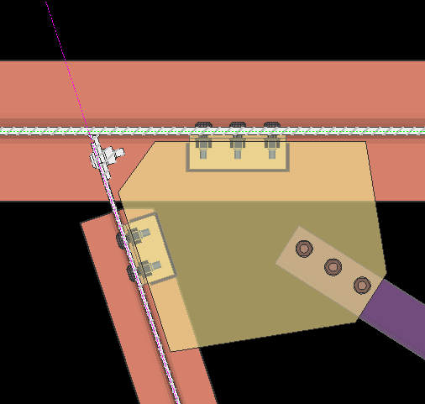
Horizontal Bracing
v2017
Connect to Skewed Beams

Slide 24
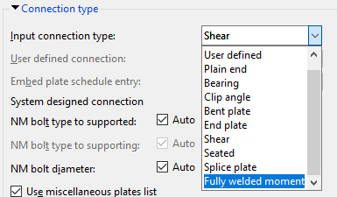
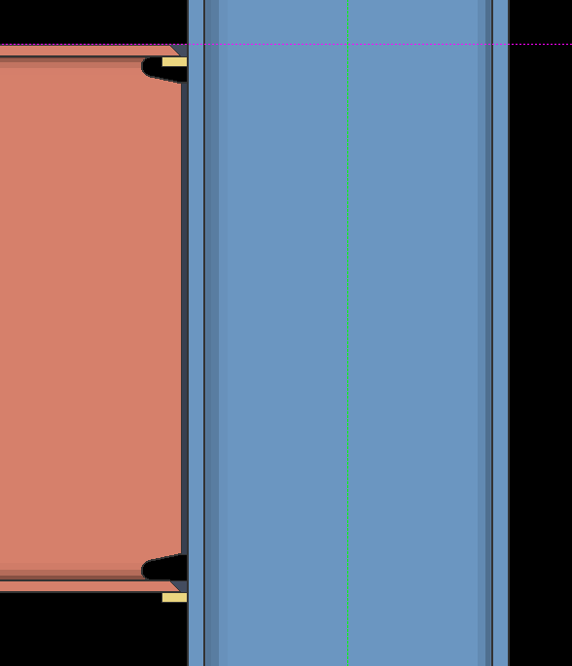
Fully Welded Moment Conn.
v2017
Beam Connect directly to Column Flange
Use with Shop Frames

Slide 25
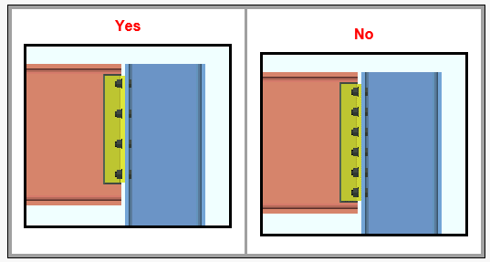
Expanded Bolt Spacing
v2017
"Use expanded vertical bolt spacing" no longer require an axial load to be operative.

Slide 26
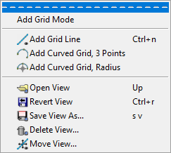
Move Grid Line
v2017
Move Multiple Grid Lines at Once

Slide 27
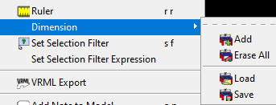
Model Dimensions
v2017
Add temporary Dimensions to the Model for Refernce

Slide 28
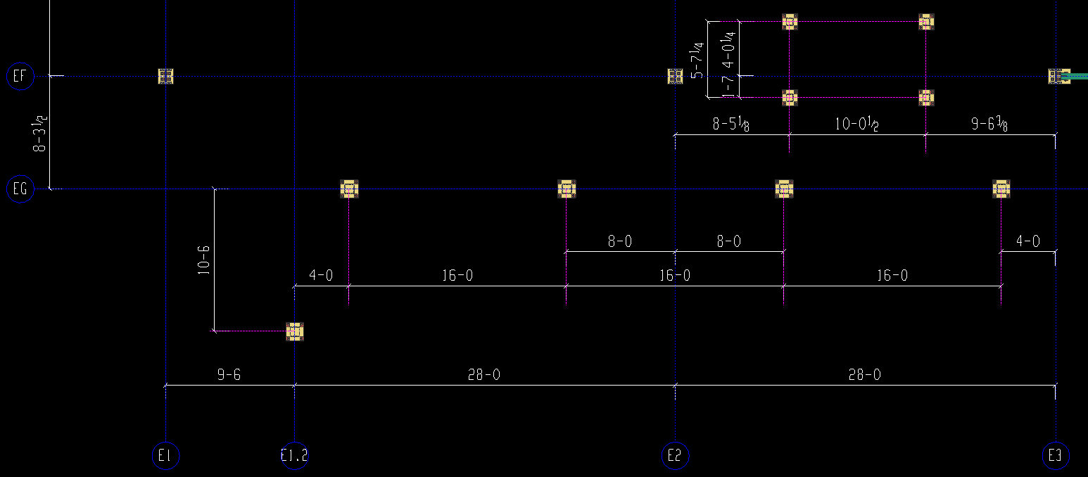
Model Dimensions
v2017
Use for Model Checking

Slide 29
Model Dimensions
v2017
Save and Load for later use

Slide 30
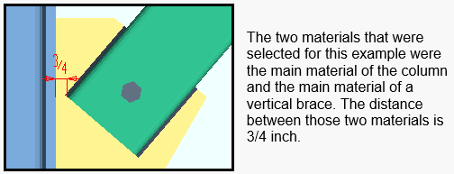
Dimension Clearance
v2017
Closest Distance between Two Materials

Slide 31
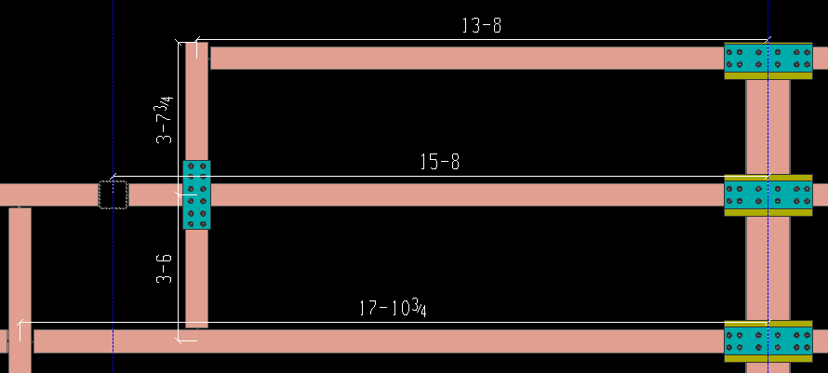
Dimension Member
v2017
Dimensions Member Length

Slide 32
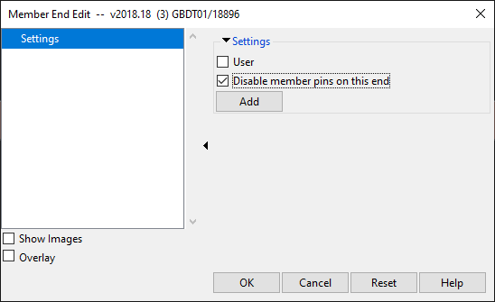
Member Pins
v2017
Member End Property

Slide 33
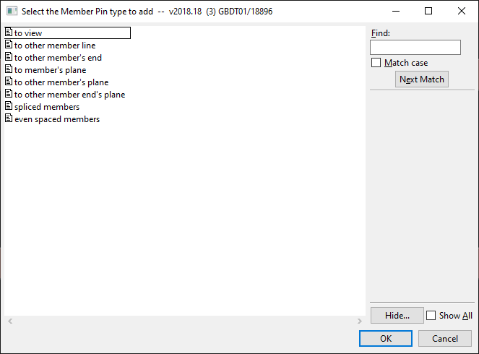
Member Pins
v2017
Types of Pins

Slide 34
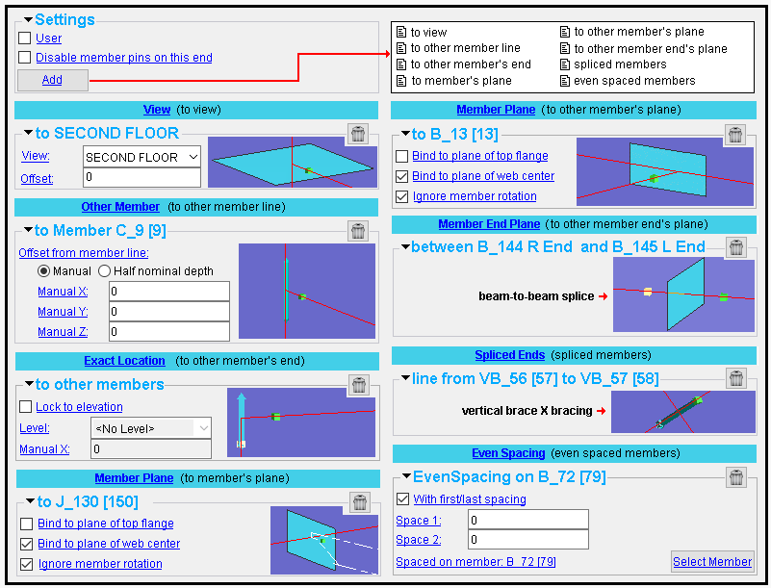
Member Pins
v2017
Types of Pins

Slide 35
Member Pins
v2017
Member End Color

Slide 36
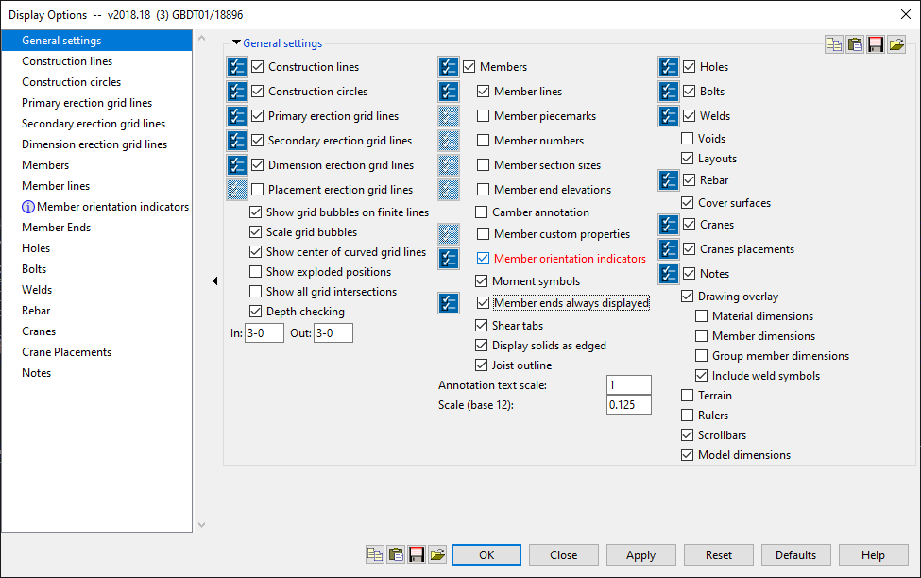
Member Pins
v2017
Member End Color

Slide 37
Member Pins
v2017
Auto Pin
Automatically Determines Member Pins

Slide 38
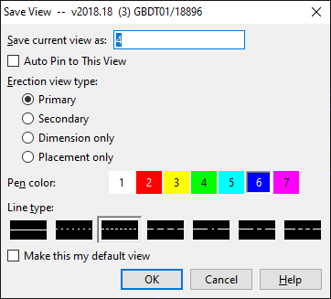
Member Pins
v2017
Auto Pin
Automatically Determines Member Pins

Slide 39
Member Pins
v2017
Pin New Member Ends
Option to Have Member Pin Disabled when adding new members.

Slide 40
Member Pins
v2017
YouTube
Help Documentation

Slide 41
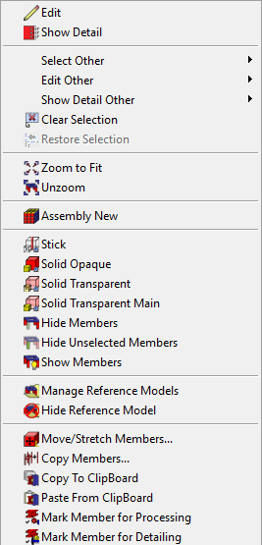
Copy Members from Job-to-Job
v2017
Right-Click “Copy to Clipboard”

Slide 42
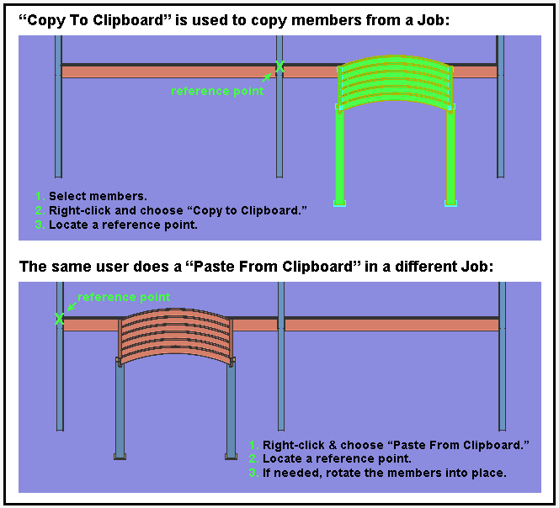
Copy Members from Job-to-Job
v2017
Copy Using Reference Point

Slide 43
New Member Types
v2017
Girt Custom Member
With Connections to Columns
YouTube

Slide 44
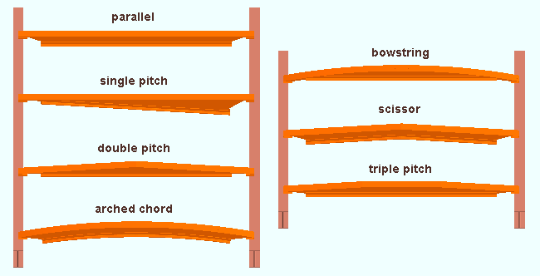
New Member Types
v2017
Joist (Hybrid of BIM Joist and Legacy Joist)
Shape

Slide 45
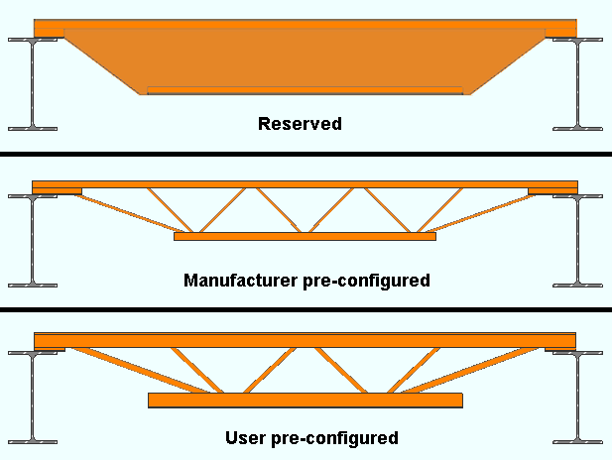
New Member Types
v2017
Joist (Hybrid of BIM Joist and Legacy Joist)
Panel Display Method

Slide 46
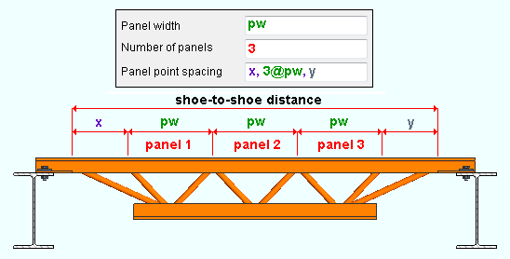
New Member Types
v2017
Joist (Hybrid of BIM Joist and Legacy Joist)
Panel Layout

Slide 47
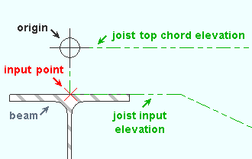
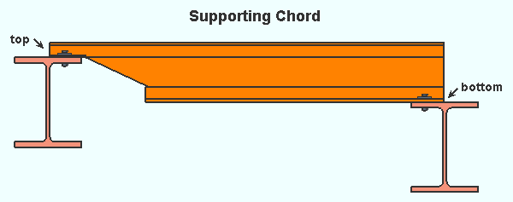
New Member Types
v2017
Joist (Hybrid of BIM Joist and Legacy Joist)
Input Method

Slide 48
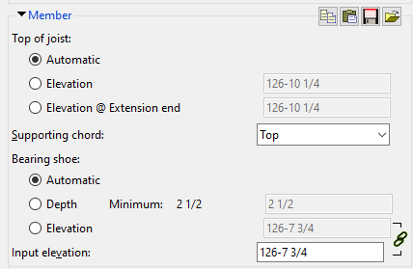
New Member Types
v2017
Joist (Hybrid of BIM Joist and Legacy Joist)
Input Method

Slide 49
New Member Types
v2017
Joist (Hybrid of BIM Joist and Legacy Joist)
Input Method

Slide 50
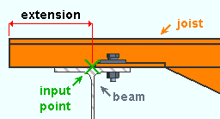
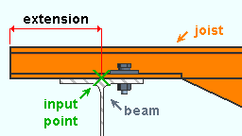
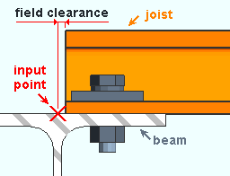
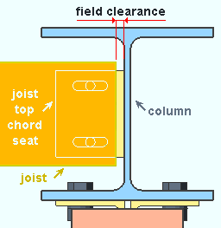
New Member Types
v2017
Joist (Hybrid of BIM Joist and Legacy Joist)
Extensions and Field Clearance

Slide 51
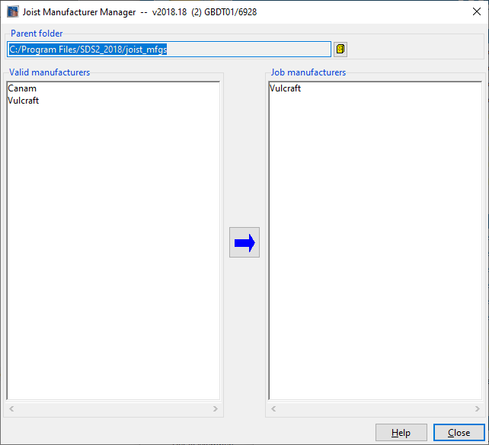
New Member Types
v2017
Joist (Hybrid of BIM Joist and Legacy Joist)
Joist Manufacturer Manager – Utility Functions

Slide 52
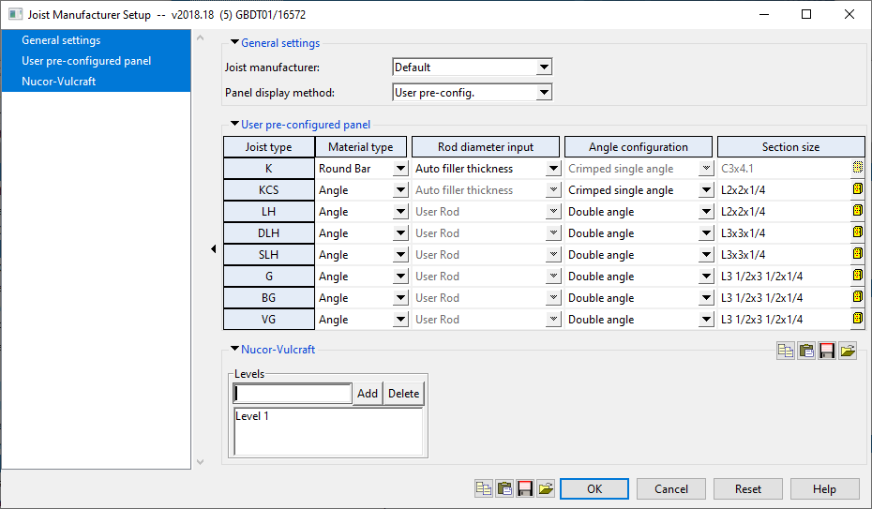
New Member Types
v2017
Joist (Hybrid of BIM Joist and Legacy Joist)
Joist Manufacturer Setup

Slide 53
New Member Types
v2017
Joist (Hybrid of BIM Joist and Legacy Joist)
Canam Tools

Slide 54
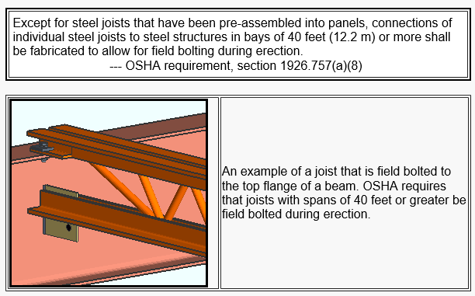
New Member Types
v2017
Joist (Hybrid of BIM Joist and Legacy Joist)
OSHA Span for Bolted Connections

Slide 55
New Member Types
v2017
Joist YouTube

Slide 56
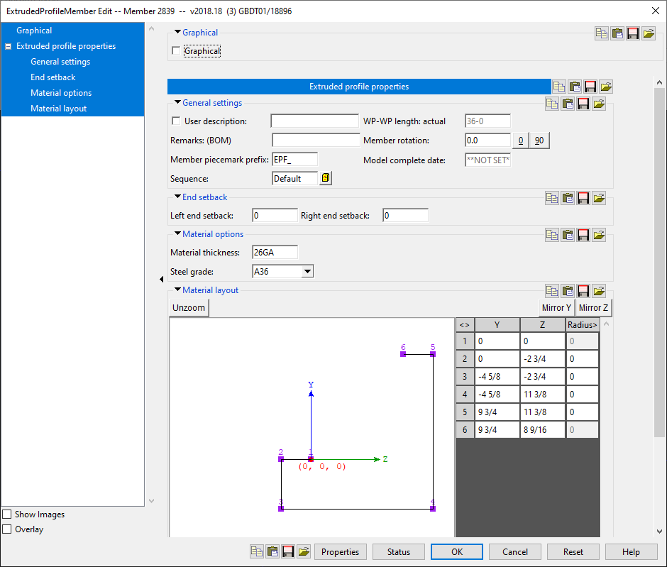
New Member Types
v2017
Extruded Profile Member

Slide 57
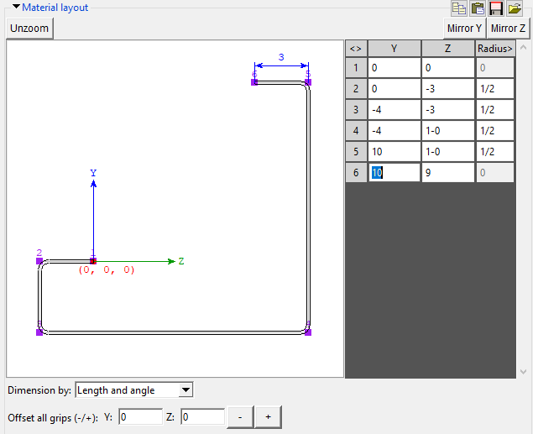
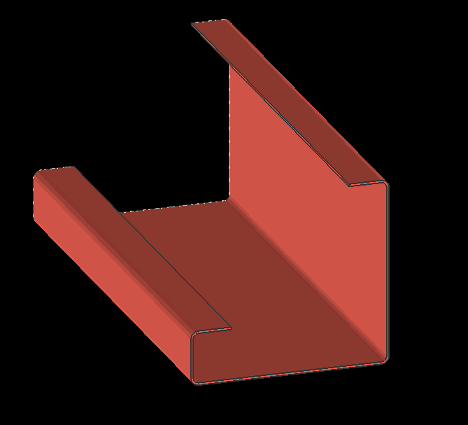
New Member Types
v2017
Extruded Profile Member – Canvas Layout

Slide 58
New Member Types
v2017
Extruded Profile Member - Save Profiles in Form

Slide 59
New Member Types
v2017
Extruded Profile Member
Need to Define Material Description

Slide 60
New Member Types
v2017
Concrete Pad Footing
Need a Concrete License

Slide 61
New Member Types
v2017
Concrete Slab
All SDS/2 Users

Slide 62
New Member Types
v2017
Concrete Slab
All SDS/2 Users

Slide 63
New Member Types
v2017
Concrete Slab - Canvas
All SDS/2 Users

Slide 64
New Member Types
v2017
Concrete Slab
Move Layout Nodes
All SDS/2 Users

Slide 65
New Member Types
v2017
Concrete Elevation Wall
All SDS/2 Users

Slide 66
New Member Types
v2017
Concrete Wall
All SDS/2 Users

Slide 67
New Member Types
v2017
Concrete Wall
All SDS/2 Users

Slide 68
New Member Types
v2017
Concrete Wall - Canvas
All SDS/2 Users

Slide 69
New Member Types
v2017
Concrete Wall
Move Layout Nodes
All SDS/2 Users

Slide 70
New Member Types
v2017
Void Space Cylinder
Void Space Layout

Slide 71
New Member Types
v2017
Void Space Cylinder
Void Space Layout

Slide 72
Model Display Options
v2017
More Visibility Control

Slide 73
Model Display Options
v2017
More Visibility Control

Slide 74
Model Display Options
v2017
More Visibility Control

Slide 75
Model Display Options
v2017
More Visibility Control

Slide 76
Model Display Options
v2017
Hide Members by Sequence in Model Display Options.
More Visibility Control

Slide 77
Model Hide Members
v2017
Right Click – Hide Members

Slide 78
Model Hide Members
v2017
Right Click – Hide Members

Slide 79
Model Hide Members
v2017
Right Click – Show Members

Slide 80
Model Hide Members
v2017
Right Click – Show Members

Slide 81
3 Ways to Hide Members
v2017
Status Display
Display Options
Right-Click Hide

Slide 82
New Components
v2017
Beam Flange Connection

Slide 83
New Components
v2017
Beam Flange Connection

Slide 84
New Components
v2017
Web Penetration with Stiffeners

Slide 85
New Components
v2017
Base/Cap Plate Stiffeners

Slide 86
New Components
v2017
Base/Cap Plate Stiffeners

Slide 87
New Components
v2017
Base/Cap Plate Stiffeners

Slide 88
New Components
v2017
Riser Closure Plate

Slide 89
New Components
v2017
Riser Closure Plate

Slide 90
New Components
v2017
Void Space Cylinder
Void Space Layout

Slide 91
New Components
v2017
E-Z Beam Release

Slide 92
New Components
v2017
E-Z Beam Release

Slide 93
Auto Standard Embed Plates
v2017
Beam to Concrete Wall
Automatic Connection

Slide 94
User Defined Embed Plates
v2017
Embed Schedule Concrete Options
All SDS/2 Users

Slide 95
User Defined Embed Plates
v2017
Embed Schedule Concrete Options
All SDS/2 Users

Slide 96
User Defined Embed Plates
v2017
Embed Schedule Concrete Options
All SDS/2 Users

Slide 97
User Defined Embed Plates
v2017
Embed Schedule Concrete Options
All SDS/2 Users

Slide 98
User Defined Embed Plates
v2017
Embed Schedule Concrete Options
All SDS/2 Users

Slide 99
User Defined Embed Plates
v2017
Embed Schedule Concrete Options
All SDS/2 Users

Slide 100
User Defined Embed Plates
v2017
Embed Schedule Concrete Options
All SDS/2 Users
Embed Angles Also

Slide 101
User Defined Embed Plates
v2017
Embed Schedule in Beam Edit
All SDS/2 Users
Define Embed Plate when
attaching to Concrete Wall

Slide 102
User Defined Embed Plates
v2017
Embed Plate Custom Member
All SDS/2 Users

Slide 103
User Defined Embed Plates
v2017
Embed Plate Custom Member
All SDS/2 Users

Slide 104
Embed Add Tools
v2017
Embed Plate Multi-Add
Embed Layout Add
All SDS/2 Users

Slide 105
Embed Plates and Concrete Walls
v2017
Warning!
May Cause Slow Processing when many Concrete Walls are used.
Model Complete Concrete Walls to avoid Processing.
All SDS/2 Users

Slide 106
Status Select
v2017
Select by Status Display Options

Slide 107
Status Display Filter
v2017
Filter by Status Display Options

Slide 108
Status Display Opacity
v2017
Opacity / Transparency by Status Display

Slide 109
Status Display Opacity
v2017
Opacity / Transparency by Status Display

Slide 110
Status Display Opacity
v2017
Opacity / Transparency by Status Display

Slide 111
Selection Dialog Status Display
v2017

Slide 112
New Status Display Options
v2017

Slide 113
New Status Display Options
v2017

Slide 114
New Status Display Options
v2017

Slide 115
Drawing Editor Tools
v2017
New Dimension Input Method
Visual Feedback
Select Rotation after Two Points
Then Continue Dimension String
Change Mode Configuration to Force Rotation
https://sds2.com/support/forums/viewtopic.php?t=13163

Slide 116
Drawing Editor Tools
v2017
Drag Off Dimensions

Slide 117
Drawing Editor Tools
v2017
Line Add Update

Slide 118
Drawing Editor Tools
v2017
Trim Lines

Slide 119
Drawing Editor Tools
v2017
Extend Lines

Slide 120
Drawing Editor Tools
v2017
Extend Lines to Intersection

Slide 121
Drawing Editor Tools
v2017
Sheet Item Add – Add Multiple Items at Once

Slide 122
Drawing Editor Tools
v2017
Sheet Item Add – Add Multiple Items at Once

Slide 123
Drawing Editor Tools
v2017
Show Moment Symbol on EVU
Regardless of Modeled Connection

Slide 124
Drawing Editor Tools
v2017
Bolt Symbols

Slide 125
Drawing Editor Tools
v2017
Bolt Symbol Combo

Slide 126
Drawing Editor Tools
v2017
Erection Views
See Previous Presentation from
2017 Users Group Conference
https://sds2.com/events/usersgroup/2017presentations

Slide 127
Drawing Editor Tools
v2017
Non-Standard Field Bolts on Erection Views

Slide 128
Drawing Editor Tools
v2017
Non-Standard Field Bolts on Erection Views

Slide 129
Drawing Editor Tools
v2017
Scale Anchor Bolt Layout

Slide 130
Drawing Editor Tools
v2017
Always Show Detail Erection View Defaults

Slide 131
Drawing Editor Tools
v2017
"Detail BOM only" no longer saves the choice that the user has made to it.

Slide 132
Stairs and Railing
v2017
See Previous Presentation from
2018 Users Group Conference
https://sds2.com/events/usersgroup/2018presentations

Slide 133
Stair Setup Options
v2017
4 Different Tread Types

Slide 134
Stair Setup Options
v2017
New Type – Plate tread
No Concrete Fill!
Checkered Plate!
Control over support and hole locaitons

Slide 135
Stair Setup Options
v2017

Slide 136
Stair Setup Options
v2017
Checkered Plate!
Setup Options changed to match desired shape.

Slide 137
Stair Edit Screen
v2017
Option to Independently customize each stair to vary tread options

Slide 138
Stair Edit Screen
v2017
Grating Profile, Plate Profile and Continuous profile allow independent modification of the top tread and bottom tread.
Great use for different support angles or tread/riser profile at Top/Bottom.

Slide 139
Stair Edit Screen
v2017
Independently change Support Angle Locations within stair edit screen.
(Pan Stair Only)

Slide 140
Stair Edit Screen
v2017
“Thickness at Landing” option replaced

Slide 141
Stair Edit Screen
v2017

Slide 142
Stair Edit Screen
v2017
CNC on Stringer

Slide 143
Stair Setup Options
v2017
Setup: Stringer Views to Always Look From Inside of Stringer

Slide 144
Stair Edit Screen
v2017

Slide 145
Stair Edit Screen
v2017

Slide 146
Stair Edit Screen
v2017
End Connection Options will Automatically Connect to Support beam.
(No Calculations)
Show Images does not work for Stair connections.

Slide 147
Stair Edit Screen
v2017
Don’t Forget to Save Form Data for Connection!
Show Images does not work for Stair connections.

Slide 148
Stair Quick Add Tool
v2017

Slide 149
Stair Quick Add Tool
v2017
Adding in Elevation View

Slide 150
Stair Quick Add Tool
v2017
Adding in Elevation View

Slide 151
Stair Quick Add Tool
v2017

Slide 152
Stair Quick Add Tool
v2017
Adding in Elevation View

Slide 153
Stair Quick Add Tool
v2017
Adding in Elevation View

Slide 154
Stair Quick Add Tool
v2017
Adding in Elevation View

Slide 155
Stair Quick Add Tool
v2017
Adding in Plan View

Slide 156
Stair Quick Add Tool
v2017
Adding in Plan View

Slide 157
Stair Quick Add Tool
v2017
Adding in Plan View

Slide 158
Stair Quick Add Tool
v2017
Adding in Plan View

Slide 159
Stair Quick Add Tool
v2017
Adding in Plan View

Slide 160
Stair Quick Add Tool
v2017
Adding in Plan View

Slide 161
Stair Riser Component
v2017

Slide 162
Stair Riser Component
v2017

Slide 163
Stair YouTube Videos
v2017

Slide 164
Railing Tools
v2017
v2017 Tools
v2018 Tools
Visual Feedback in Model during Operation in v2018

Slide 165
Stairs and Railing
v2017
See Previous Presentation from
2018 Users Group Conference
https://sds2.com/events/usersgroup/2018presentations

Slide 166
Railing YouTube Videos
v2017

Slide 167
Railing YouTube Videos
v2017

Slide 168
Python Enhancements
v2017
PR 2714
PR 11170
PR 17097
PR 29641
PR 31341
PR 34546
PR 34579
PR 34580
PR 34582
PR 34729
PR 34746
PR 35188
PR 36072
PR 36074
PR 36276
PR 36307
PR 36400
PR 36428
PR 36524
PR 36568
PR 36826
PR 36940
PR 37073
PR 37118
PR 37405
PR 37524
PR 38196
PR 39319
PR 39376
PR 39427
PR 39423
PR 39645
PR 39708
PR 39802
PR 40018
PR 40162
PR 40313
PR 40840
PR 40843
PR 40969
PR 41046
PR 41458
PR 41727
PR 41768
PR 41843
PR 41998
PR 42181
PR 42193
PR 42372
PR 42421
PR 42701
PR 42852
PR 43250
PR 43185
PR 43358
PR 43628
PR 43703

Slide 169
Minor Enhancements
v2017
Group Member Dimensioning Improvements

Slide 170
Minor Enhancements
v2017
New Feature: "Persistent Ruler"

Slide 171
Minor Enhancements
v2017
The FortoseExport plugin has been added to SDS/2 releases

Slide 172
Minor Enhancements
v2017
IGES files can now be imported as either reference models or library parts
SDS/2 jobs may now be exported to the IGES file format
SDS/2 models may now be exported to AP203/214 STEP files

Slide 173
Minor Enhancements
v2017
Beams may now be added vertically. However, connection design for vertical beams is not supported at this time and must be forced to get connection material.

Slide 174
Minor Enhancements
v2017
Added the ability to have single angle braces or double angle back to back braces welded directly to the gusset.

Slide 175
Minor Enhancements
v2017
IFC files may now be imported with members being set to system-generated

Slide 176
Minor Enhancements
v2017
Users can now add member pins from the member end edit screen.

Slide 177
Minor Enhancements
v2017
SDS/2 now exports files for the Zeman Beam Assembler
ZemanExport in now included in SDS/2 releases. This plugin requires a DSTV license to work properly.

Slide 178
Upgrading Tips
v2017
Configuration File Overwriting
Copying Configuration from Previous Versions will not have all of the SDS/2 tools available (i.e. Right-Click Menu)
Toolbar Icons
Review All Toolbar Icons to see what is new.
Add New Icons when Necessary
Review Enhancements and Release Notes
Make any updates to Seed Jobs as necessary

Slide 179
Summary
v2017
A lot of features are included in each major release.
Do research to get the best results

Slide 180
Questions?
v2017

